Slide 1
COVaxON Supports From OntarioMD and Reports Via Health Report Manager
MOH and Public Health Unit Meeting
June 29 2021
Cynthia MacWilliam Executive Director Client Services & Engagement
OntarioMD

Slide 2
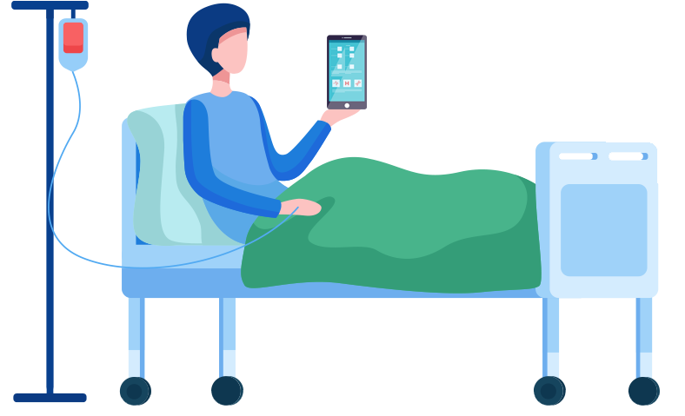
Has been available to physicians and other clinicians for many years. Over 12,000 clinical users including
+ 8,400 family doctors, 1,500 Nurse Practitioners and + 2000 specialists
Practice Benefits
Notifications of positive COVID-19 lab results available in OLIS
Information on patient hospital visits arrives sooner
Saves time: 30 minutes of clinic time per day
Administrative cost avoidance (handling paper, scanning) and operational savings (paper, toner, etc.)
Patient Benefits
Improved transitions, coordination of care and patient safety
Faster follow-up after hospitalizations to reduce the complications or re-admissions
OntarioMD is a wholly owned subsidiary of the Ontario Medical Association
Notes:
HRM is a multi-award-winning digital health solution
It lets you receive patient reports (e.g., discharge summaries) from hospitals and specialty clinics into certified EMRs – an OMD-developed digital solution
Safer, more efficient delivery of important, time-sensitive patient information
Allows physicians to immediately act on information and follow up with patients sooner
A must-have product for every physician!

Slide 3
COVID-19 vaccination reports delivered by HRM: PCP field filled
HRM® began delivering COVaxON vaccination reports to primary care providers’ EMRs as of May 18, 2021.
COVaxON vaccination reports through HRM appear in EMR in the same manner that medical record reports appear now from HRM.
This initial release of the COVaxON-HRM solution is limited to primary care providers who are named in a COVaxON vaccination report and who use HRM.
This initial release of the COVaxON-HRM solution is not sending COVaxON vaccination reports for patients vaccinated before May 18, 2021.

Slide 4
COVID-19 vaccination reports delivered by HRM: PEM matching
For PEM (patient enrolled model) physicians
- where PCP field in COVaxON is not filled,
- OH (Ontario Health) is matching the patient vaccination events against CAPE data to identify the PEM PCP.
- This is expected to happen July 15
At the moment there is no solution for non-PEM doctors to get vaccination information for their patients unless the PCP field has been filled. Similarly for Pediatricians.

Slide 5
Historical Reports
OntarioMD (OMD) is working with the Ontario Ministry of Health and Ontario Health to send vaccination event information for vaccinations that were administered prior to go-live i.e. before May 18
Based on feedback from OntarioMD Peer Leaders and possible volumes the recommendation is to send these individual patient reports in batches
Ontario Health is also working on making this data available in report form for clinicians through eReports

Slide 6
COVaxON Training and Resources
OntarioMD training sessions and videos on how to access and use the COVaxON system can be found on the COVaxON Training for Primary Care Practices page
Also provide:
Assistance with bulk patient uploads (PHU permitting)
EMR specific tools on how to identify patients to be vaccinated
EMR specific tools on handling HRM reports
Working with Ontario Health (Dr. Kaplan team) on tools to handle eReports

Slide 7
IMPORTANT: Entering vaccines
Best practice is to enter the vaccine at the time of injection
Some clinics have choses to batch enter them at a later time or later date
If you back date the vaccine to the time of injection, the data will not be sent via HRM (regardless if whether PCP field is filled)
The COVaxON system sends data to HRM in segmented times going forward. So if you enter a vaccine and you have back dated it, then it won’t be “seen”.

Slide 8
How Can I Get HRM?
If you are a clinician and use a certified EMR, contact:
support@ontariomd.com
and ask for access to HRM

