Slide 1
Healthy Relationships
Notes:
Notes to presenter:
-this presentation directly supports the H&PE Curriculum, Healthy Living Strand, in Grade 8 – C3.2 Relationships and intimacy, Grade 9 – C2.2 Relationships – skills and strategies
Before presenting to students, please review content in advance with classroom teacher or other school staff to ensure appropriateness. Addressing Healthy Relationships with younger students (e.g. elementary) is important but content is focused differently.
-provide a “sensitive topic” statement and make students aware of supports available in school (e.g. have social worker on standby/available for drop ins, Guidance, trusted adult)
______________________________________________________
Sample Speaker Notes:
-Welcome & Introduction
-Today we will be talking about Healthy Relationships
-Talking about Healthy Relationships can be hard. If you feel that you need advice, please talk to a teacher, parent, school social worker or other adult you trust.
-We won’t address individual situations during the presentation (privacy) but you can speak to someone after if you like.

Slide 2
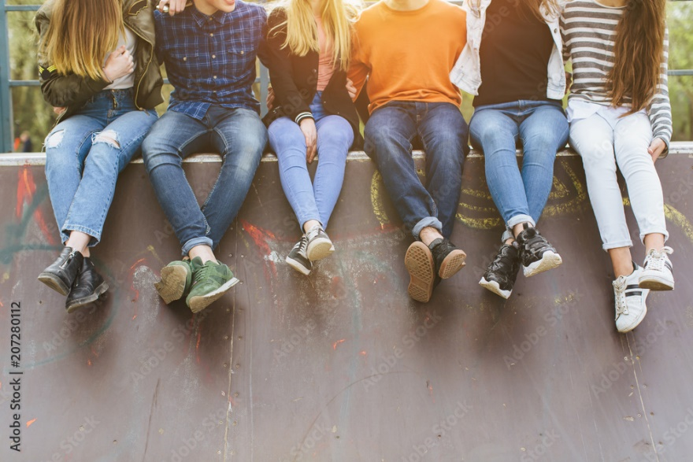
Relationships
Relationships can develop with a number of people including: family members, friends, coworkers, as well as people you are dating.
Healthy relationships can be rewarding and are important for everyone.
Healthy relationships can make us happier and add to our feelings of self-worth.

Slide 3
Notes:
No one type of relationship is ‘normal’ – but all relationships deserve respect.
Gender identity is what gender you identify with, and how you express your gender to the world.
People who’s gender identity does not match their reproductive organs are considered transgendered, meaning that they identify with a gender that is different from their biological sex.
Some people may have sexual organs or hormones from both sexes; this is called being intersex.
Gender expression is how you express your gender to the world – through things like how you dress, act, and behave
Biological sex is the sex organ you are born with. Some people are born with organs or hormones from both sexes – this is called being intersex.
Sexual Orientation is who you are attracted to physically, spiritually, and emotionally. This may include being attracted to someone of the same or opposite sex as you. This may also include being attracted to both sexes.
Some sexual orientations you will identify with, and some you will not.
Regardless of your own sexual orientation, you will go to school, work, and be friends with people who may identify with a different sexual orientation then yourself.
We all need to be able to respect every person we come into contact with, regardless of their sexual orientation.

Slide 4
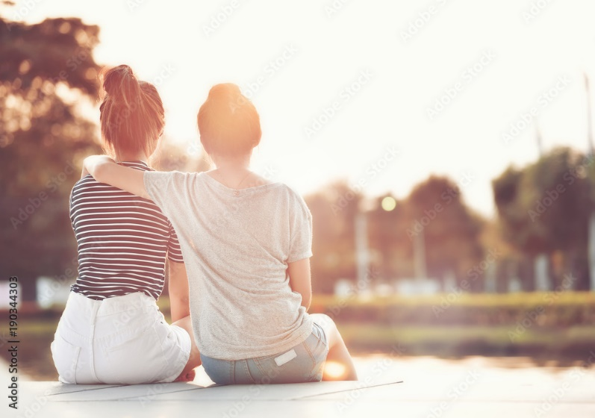
Healthy relationships start with you!
When you are confident and happy with yourself, others will be drawn to you.
We all have talents, strengths and parts of our personality that are great.
We all have things we want to work on – no one is perfect.
Notes:
Before you enter into a relationship (friends, dating etc) it is important to acknowledge and accept yourself for who you are. No one is perfect and each of us have talents and qualities that make us unique.
Some qualities of a healthy relationship include good communication, problem solving and decision making skills.
Everyone here has parts of them that make them special and unique, parts of yourself that make you who you are.
Maybe you’re a funny person, or a quiet person, or a really athletic person. Maybe you love watching sports or reading or spending time with your friends.
When thinking about romantic relationships, these are things that you will still enjoy doing when you are in a romantic relationship, and they aren’t parts of yourself that will change in a romantic relationship.
It’s important to be comfortable with who you are, and for your partner to be accepting of that as well.

Slide 5
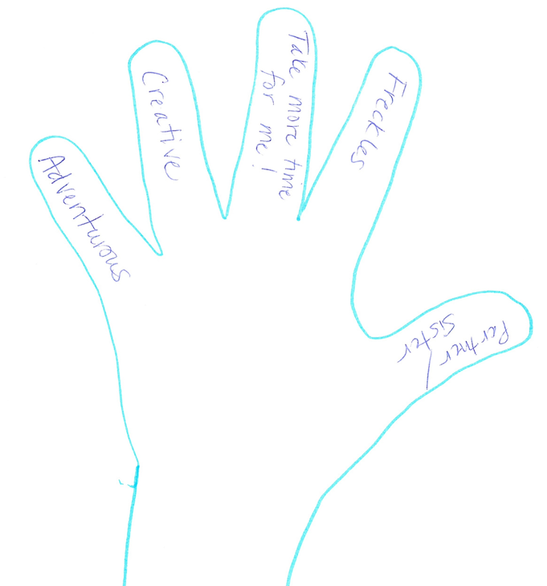
Activity – Looking at myself
Trace your hand and number your fingers for the corresponding 5 questions:
Name one characteristic about yourself that makes you feel proud.
What is your strongest, positive personality trait?
List one thing you would like to change or improve about yourself.
What is your best physical characteristic?
Who could you turn to if you needed help?
Notes:
Give each student a black piece of paper and have them trace their hand. Have them answer the five questions and write their answers on each finger. Provide prompts or an example if needed.
1)
Persistent Genuine Patient
Happy Friendly Thoughtful
Kind Reliable Introverted
Warmhearted Loyal Bright
Easygoing Adventurous Emotional
2) Honesty
Responsible
Adaptable
Driven, determination, persistence
Compassion, empathetic
Confident
Compassionate
Loyal
Adventurous
Creative
Helpful
Optimistic
Reliable
Dependable
Sociable
Encouraging
Humble
4) Your physical features are your height, weight, size, shape or another bodily characteristic. These also include facial features, hair, scarring and birthmarks. Physical features may also include piercings, tattoos or body modifications.
5) Family, friends, trusted adult

Slide 6
What shapes our relationships?
Parents
Friends
Media
Celebrities/Sports Images
Culture/Community
Notes:
Ask students if they can identify influences that shape our relationships with others.
Explain that by relationships you mean relationships with dating partners, parents/family, siblings, friends, teachers, etc. Ask for volunteers to share their thoughts.
Possible responses might be, media, culture, family.
Discuss how these influences shape their views of relationships – brainstorm ideas about how each particular topic influences their views of relationships or what messages they are sent about relationships from that particular topic.
Parents
• If a parent is controlling, you might think that is how you get what you want
• If you see a parent who is drunk/under the influence of drugs treating your
other parent in an unhealthy way, you might think it’s ok to treat people like this
• If parents fight a lot, you might think this is normal
• If parents take on traditional roles, then you might think this is how it is
supposed to be in your own relationships
• Parents sometimes tell you who you can be friends with or date
• If parents don't support your gender expression or sexual orientation, it may be
difficult for you to have a positive sense of self
Friends
• Sometimes ignore certain people/form cliques, etc.
• Sometimes make you think that everyone is doing a certain thing (i.e. drinking,
having sex, cutting, etc.) and there is something wrong with you if you don’t
• Make us think that no one gets along with their parents, when in fact this is
not the case
• Sometimes treat certain adults in a negative way and then it makes us feel like
we should too
• Don’t always like our choice of dating partner so may try to influence us
Media (music, movies, ads, television, magazines, social media, etc.)
• Creates stereotypes of men and women, making us feel like certain people are
just objects without thoughts, feelings, etc.
• Makes us believe that relationships are just about quickly falling in love
followed by having sex
• It’s ok to just have sexual relations with many partners
• Everyone is drinking/doing drugs because that is part of the relationship
• Pornography may give an unrealistic view of what to expect in intimate relationships
Celebrities/Sports Images
• Make us believe that women are just there to be used and abused and that you
can get away with this as long as you are a celebrity/good athlete
• Teach us that violence is acceptable and desirable to get what you want
• Certain people are above everyone else and can have many partners, etc.
because of “who” they are
• Physical abuse is acceptable if you are a professional athlete/celebrity
Culture/Community
• Some views may make us believe that one gender is superior to the other
• Marriage is arranged in some cultures
• That you must get married in order to be a valued member of society
• You must do everything you can to make a relationship work, and if it isn’t
working, it is your fault
• Shame the family if you don’t marry
• Disowned in some cultures/communities if you are LGBTQ
Adapted from Healthy Relationships Plus Program (4th R)

Slide 7
What is a healthy relationship?
Snowball activity
Can you think of examples/characteristics of what makes a healthy relationship?
What would be an example/characteristic of an unhealthy relationship?
What are some ways to get out of an unhealthy relationship or how would you help a friend get out of one?
Notes:
**Use snowball activity
Optional - Have students brainstorm ideas and write them on the board for all to see (add any examples as needed).
Remind students that they can think of examples from their relationships with family, friends and classmates and/or romantic/dating.
Both people want to be in the relationship
Both people feel good (brings out the best in each other)
Each partner helps the other partner out when they need it
Both people are comfortable being themselves
Each partner brings out the positives in the other (talents, strengths) to be a better person
People in Healthy Relationships:
Talk with each other easily
Trust each other
Respect each other
Are honest
Laugh together
Accept differences
Share similar interests
Are able to respectfully work through disagreements
Unhealthy Relationships:
Try to control the other – can’t be yourself
Be afraid to disagree
Discourage of limit other close friendships
Be overly possessive or jealous
Prevent on another from doing things you enjoy
Criticize or humiliate one another in front of others
Push, shove, grab, hot or throw objects or physically be aggressive in any way
Harm or threaten to harm each others person objects
Do physical, emotional or sexual harm
Lie or fail to tell each other important things about yourself
It is everyone's right to end unhealthy relationships. Trust your instincts and discuss your feeling with someone you trust.
Talk with a friend, parent or trusted adult
If ending a relationship:
Be clear – Don’t lie, avoid the other person, be manipulative or play games
Be Respectful – Communicate your feelings and your intention to the relationship clearly and compassionately, don’t wait the drag it out.
Be Honest

Slide 8
Green light (healthy relationship) Based on equality and respect.
Make decisions together
Openly discuss challenges
Enjoy spending time together or apart
Notes:
Remind students that these aspects of relationships can be with family, friends and classmates, and in dating relationships.

Slide 9
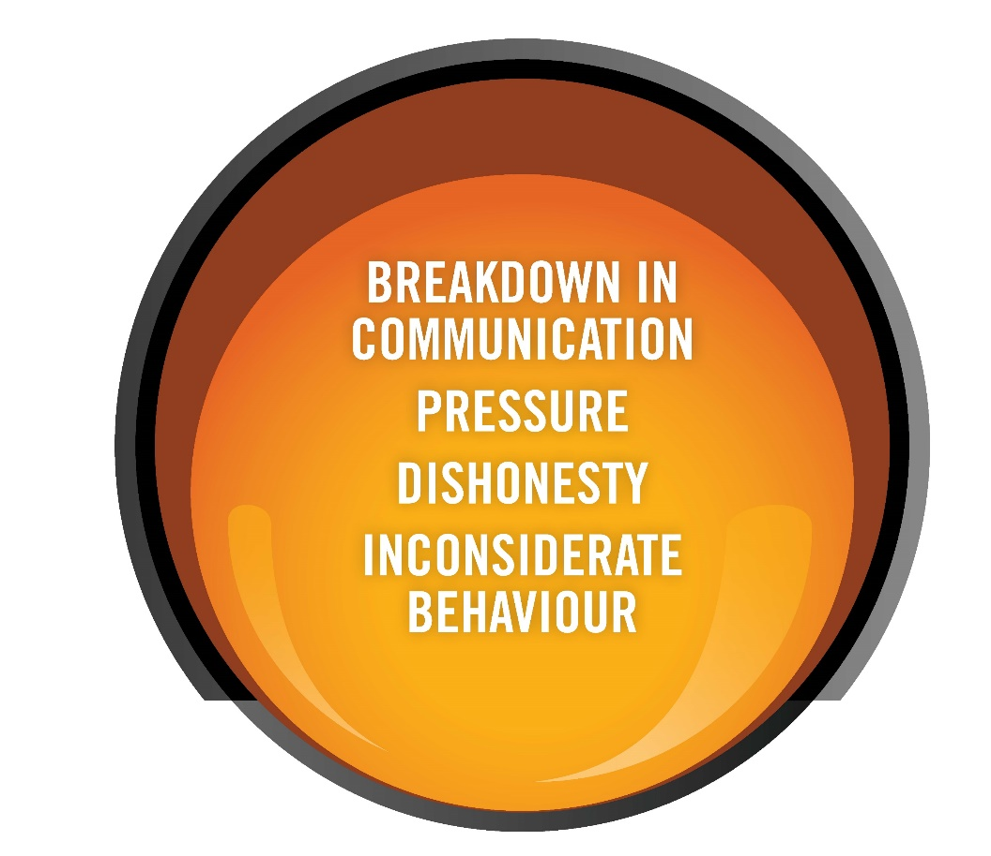
Yellow light (unhealthy relationship) Based on attempts to control the other person.
One person tries to make most of the decisions.
One person pressures their partner about sex.
One person does not see how their actions can be hurtful.
You feel pressured to spend time only with your partner.

Slide 10
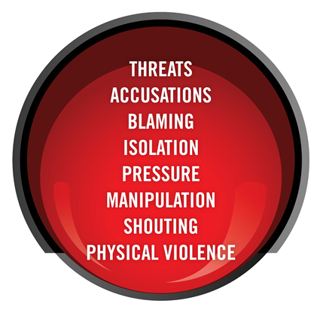
Red Light (abusive relationship) Based on power and control.
One person makes all of the decisions about friends, boundaries, and sexual choices.
You feel pressure to spend all your free time together.
There are mind games that make you feel guilty or crazy.
You may be afraid to talk about what is really happening in the relationship.
You may be living in fear because of threats or acts of physical violence
Your belongings may be destroyed.

Slide 11
How do I know if I’m in a healthy relationship?
Notes:
Healthy relationships make you feel good about yourself and your partner and have at least five things in common - the S.H.A.R.E. qualities.
Safety: You are not worried about being harmed emotionally or physically, and you don’t feel tempted to harm the other person either.
You are free to change your mind about something, like having sex, without being afraid of how your partner will respond.
Honesty: You don’t hide anything important from your partner, and can say what you think without fear of being ridiculed.
You can admit to being wrong, and you resolve disagreements by talking honestly without being worried that your partner will end the relationship.
Acceptance: You accept each other as you are. You appreciate your partner’s unique qualities, such as shyness, and don’t try to “fix” them or change them.
If you don’t like your partner’s qualities, you shouldn’t be with that person.
Respect: You think highly of each other. You do not feel superior or inferior to your partner in important ways. You respect each other’s right to have separate opinions and ideas.
Enjoyment: A good relationship is not just about how two people treat each other - it also has to be enjoyable. You can play and laugh together. You have fun.

Slide 12
I.D.E.A.L.
IDENTIFY the problem.
DESCRIBE all the possible solutions.
EVALUATE the consequences of each solution.
ACT – Choose a solution and try it.
LEARN – Did it work? Why? Why not?
Notes:
People are making decisions all the time – including when you are in a relationship.
Some decisions that you made today may be decisions like:
How did you decide what to wear to school this morning? How did you decide what to have for breakfast?
When making a decision it is always important to be aware of all the possible consequences and ways to avoid negative consequences.
It is important to recognize that different cultures & religions support various values that influence our decisions.
So now we will look at a way to help make decisions called I.D.E.A.L
I. The first part is identifying the problem. Sometimes when we are making decisions about relationships we have many of feelings and thoughts, and it might be hard to know what the problem actually is. Sometimes, we just know that something isn’t right but we don’t know what. It is really important to stop and take the time to identify what the problem is.
D. Next, think about all of the possible solutions to the problem. These can be good or bad solutions and right now we are just brainstorming options.
E. After brainstorming, we need to think about the consequence or outcome from each solution. Again, these can be positive or negative.
A. Next we need to pick a solution. We can work through all of the potential outcomes, but at some point we have to make a choice and see how it goes. Using the scenarios pick the solution that you think is best.
L. Finally, we learn from all of our choices. We make great choices, and we make poor choices. The important thing is looking at the decisions we have made and deciding if we would make the same decision again. It is important that we learn from our choices.

Slide 13
I.D.E.A.L. activity
In your groups, read your scenario. Identify the problem and come up with 2 solutions. Think about each solution, and select the best option for your group.
Notes:
Break students into 6 groups. Give each group an IDEAL worksheet (or show slide above) and a scenario. ***Print ahead of time
In their groups, read the scenario. Identify the problem and come up with 2 solutions. Think about each solution, and select the best option for the group.
Read through each scenario as a class and review problem and solution.

Slide 14
I.D.E.A.L. activity
Scenario 1
Holly and her best friend Deedee are in Grade 7. They do everything together and Holly spends a lot of time over at Deedee’s house. Deedee has an older brother Nick, who is in high school. Nick is always teasing Deedee and Holly about the changes their bodies are going through. Holly is feeling uncomfortable with the attention she is receiving from Nick.
Notes:
Problem: Holly is uncomfortable with the attention Nick is paying to her body.
Potential solutions:
Holly can talk to Nick
Holly can talk to her parents
Holly and Deedee can spend time at Holly’s house
Holly can do nothing
Consider asking students to write specific phrases or sentences that they would say to Nick or their parents.

Slide 15
I.D.E.A.L. activity
Scenario 2
Sam is a new student at your school. His family left their previous community because Sam was being bullied about his same-sex parents. Meet the teacher night is coming up and Sam is worried about how his family will be accepted.
Notes:
Problem: Sam is worried that: his family won’t be accepted; worried he might get teased/bullied; and will it affect new friendships etc.
Potential solutions:
Sam can ask his parents not to attend
Sam can talk to his teacher
Sam can tell his friends about his parents

Slide 16
I.D.E.A.L. activity
Scenario 3
Kim and Jamie have been dating for some time. Lindsay is a good friend of Kim’s. Lindsay has heard that Jamie has been seeing someone else without Kim knowing. Lindsay feels the need to talk to Kim about this but isn’t sure if she should.
Notes:
Problem: Lindsay is unsure if she should tell her friend Kim that she thinks Jamie is cheating on her. Lindsay does not have evidence that cheating is happening.
Potential solutions:
Lindsay tells Kim and they confront Jamie about it
Lindsay tells Kim and she thinks Lindsay is lying
Lindsay doesn’t say anything and when Kim finds out she is upset with Lindsay for keeping it a secret; etc.

Slide 17
I.D.E.A.L. activity
Scenario 4
Chris and Dakota have been dating for 8 months. Recently Chris has been pressuring Dakota to have sex by saying things like “If you love me, why don’t you want to be with me?” Dakota isn’t sure what to do.
Notes:
Problem: Chris wants more intimacy in the relationship, but Dakota does not.
Potential Solutions:
Chris and Dakota can have sex
Dakota can tell Chris how they feel and the relationship ends
Dakota can tell Chris how they feel and they can agree on boundaries
Consider asking students to write down what they would say if they were being pressured to do something they were not comfortable with ex. – “If you loved me you wouldn’t pressure me to do something I am not ready to do.”

Slide 18
I.D.E.A.L. activity
Scenario 5
Taylor and Lee are in a relationship. Lee is always trying to change things about Taylor’s appearance. Every time Taylor walks into the room, Lee will say things like, “Why are you wearing that? Your hair looks horrible. I’m not going out with you looking like that!” Taylor feels hurt that Lee is never happy about the way they look.
Notes:
Problem: Taylor doesn’t like the way Lee talks to them and makes them feel
Potential Solutions:
Taylor communicates with Lee their feelings about the situation
Taylor says nothing and continues to feel the same way
Taylor ends the relationship

Slide 19
I.D.E.A.L. activity
Scenario 6
Alana and Jodi have been close friends since elementary school. They were always in the same classes and spent most of their time outside of school together. When they get to high school they are in different classes. Alana decided to try out for volleyball and get involved in student council. Jodi feels like they haven’t been spending must time together and she tells Alana that she feels like Alana ditched her. Even though Jodi has a few other friends, she starts to feel like she has done something wrong. She starts to tell herself that Alana doesn’t like her anymore because she isn’t popular or athletic enough.
Notes:
Problem: Jodi is feeling line Alana doesn’t like her anymore
Potential Solutions:
Jodi could talk with Alana about her feelings
Jodi says nothing and continues to feel the same way
Jodi ends the relationship

Slide 20
People and places that can help
Trusted adult – parent, teacher, coach, friend
Health care provider
Child youth worker/ School social worker
School public health nurse
Sexual Health Clinics
Kids Help Phone: 1-800-668-6868
Notes:
Emphasize to students that there are many people and places they can reach out to in order to get help or ask questions about relationships and sexual health.
Among these are:
A trusted adult (such as a parent or teacher)
A health care provider (such as a doctor or nurse)
A child youth worker, school social worker
The school public health nurse
Any of the HPE Sexual Health Clinics
Kids Help Phone

Slide 21
Questions?

