Slide 1
Sexually Transmitted Infections
(STIs)
Notes:
Notes to presenter:
-this presentation directly supports the H&PE Curriculum, Healthy Living Strand, in Grade 7 D1.4 Sexually transmitted and blood-borne infections (STBBIs) and D1.5 STBBIs and pregnancy prevention, Grade 9 C1.4 Preventing pregnancy and STIs (could also be used for higher grades (7+)).
Before presenting to students, please review content in advance with classroom teacher or other school staff to ensure appropriateness.
-provide a “sensitive topic” statement and make students aware of supports available in school (e.g. have social worker on standby/available for drop ins, Guidance, trusted adult)
______________________________________________________
Sample Speaker Notes:
-Welcome & Introduction
-Today we will be talking about sexually transmitted infections or STIs
-If you feel that you need advice, please talk to a teacher, parent, school social worker or other adult you trust.
-We won’t address individual situations during the presentation (privacy) but you can speak to someone after if you like.

Slide 2
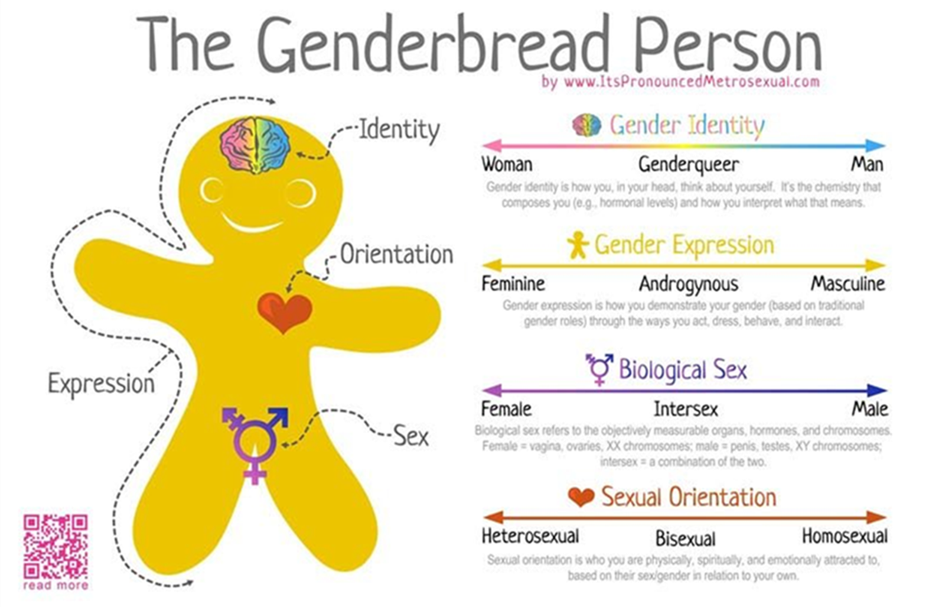
The Genderbread Person
Notes:
No one type of relationship is ‘normal’ – but all relationships deserve respect.
Gender identity is what gender you identify with, and how you express your gender to the world.
People who’s gender identity does not match their reproductive organs are considered transgendered, meaning that they identify with a gender that is different from their biological sex.
Some people may have sexual organs or hormones from both sexes; this is called being intersex.
Gender expression is how you express your gender to the world – through things like how you dress, act, and behave
Biological sex is the sex organ you are born with. Some people are born with organs or hormones from both sexes – this is called being intersex.
Sexual Orientation is who you are attracted to physically, spiritually, and emotionally. This may include being attracted to someone of the same or opposite sex as you. This may also include being attracted to both sexes.
Some sexual orientations you will identify with, and some you will not.
Regardless of your own sexual orientation, you will go to school, work, and be friends with people who may identify with a different sexual orientation then yourself.
We all need to be able to respect every person we come into contact with, regardless of their sexual orientation.

Slide 3

STI: True or False?

Slide 4
STI True or False – Question 1
“I don’t have any symptoms, so I don’t have an STI.”

Slide 5

STI True or False – Answer 1
People can be infected with an STI and have no symptoms!
Many STIs won’t show symptoms when the infection first starts
Around 70% percent of women and 50% of men with chlamydia have no symptoms
Notes:
https://myhealth.alberta.ca/sexual-reproductive-health/sexually-transmitted-infections
https://www.sexandu.ca/stis/chlamydia/
https://myhealth.alberta.ca/sexual-reproductive-health/sexually-transmitted-infections/gonorrhea

Slide 6
STI True or False – Question 2
“Once you have had an STI and have been cured, you can’t get it again.”

Slide 7

STI True or False – Answer 2
You can get re-infected with an STI, even if you have had one before and got treated
Always practice safer sex
  Wear a condom
  Get tested for STIs with each new partner

Slide 8
STI True or False – Question 3
“STIs that are left untreated can cause infertility, pelvic inflammatory disease and epididymitis.”

Slide 9

STI True or False – Answer 3
If left untreated in women they can lead to pelvic inflammatory disease
  Infertility
  Ectopic pregnancies
  Life long pelvic pain
If left untreated in men they can lead to epididymitis
  Infertility
  Ongoing problems with swelling in the scrotum, testicles or epididymis
Notes:
PID is a serious infection of the female reproductive organs (uterus, fallopian tubes, and ovaries).
Signs and symptoms of PID: pain when having sex, vaginal discharge, nausea and/or vomiting, feeling unwell and tired, pain in the lower abdomen or back, chills or fever (temperature over 38.5 °C) and irregular vaginal bleeding.
PID is treated with antibiotics.
Epididymitis is a swelling of the testicles and the tube next to the testicle(s) that stores sperm (epididymis).
Signs and symptoms of epididymitis: swelling of the epididymis and/or testicle(s), redness or swelling of the skin covering the testicles (scrotal skin) clear, creamy-white, or yellow discharge from the end of the penis, pain or burning when you pee, fever (temperature over 38.5 °C)
Epididymitis is treated with antibiotics
https://myhealth.alberta.ca/sexual-reproductive-health/sexually-transmitted-infections/pelvic-inflammatory-disease
https://myhealth.alberta.ca/sexual-reproductive-health/sexually-transmitted-infections/epididymo-orchitis

Slide 10
STI True or False – Question 4
“Birth control pills offer protection from STIs.”

Slide 11
STI True or False – Answer 4
Birth control does not protect you from STIs
The purpose of birth control is to help prevent pregnancies

Slide 12
STI True of False – Question 5
“Condoms and dental dams can help prevent the spread of STIs.”

Slide 13

STI True or False – Answer 5
Condoms and dental dams can help prevent the spread of STIs
Notes:
Latex, polyurethane and polyisoprene condoms are effective for preventing most sexually transmitted infections
https://www.sexandu.ca/contraception/non-hormonal-contraception/

Slide 14
STI True or False – Question 6
“Most STIs go away without treatment, if people wait long enough.”

Slide 15
STI True or False – Answer 6
STIs will not go away without effective treatment
  Need to follow the guidelines for treatment
  Ignoring symptoms can lead to more complications
  Peeing after sex does not prevent you from getting and STI

Slide 16
STI Autograph Game
Discuss some names and characteristics of common STIs
Discuss one reason people do not protect themselves from STIs
Discuss two ways people can protect themselves from STIs
Notes:
OPTIONAL: STI AUTOGRAPH GAME CAN BE USED TO DEMONSTRATE HOW QUICKLY STIs CAN SPREAD AND THE IMPORTANCE OF PROTECTION/ABSTINENCE
(add link to game instructions)

Slide 17
Types of STIs
Bacterial
Chlamydia
Viral
HPV
Parasitic
Trichomoniasis “Trich”
Gonorrhea
Syphilis
Herpes
HIV
Hepatitis B
Notes:
Other parasitic: Public Lice and Scabies (not covered in presentation)

Slide 18
How do STIs spread?
STIs
Oral sex
Vaginal sex
Sharing equipment
Anal sex
Infected mom to baby
Skin to skin contact
Bodily fluids
Notes:
People can be infected with an STI and have no symptoms! Many STIs will not have symptoms.
Bodily fluids→ Blood, semen, vaginal fluid, rectal fluid, breast milk
Skin to skin contact→ Herpes can spread from areas that are not covered by a condom
Mom to Baby→ During pregnancy, through birth, through breastfeeding
Sharing equipment→ Needles, Tattoo and body piercing equipment, sex toys, razors, toothbrushes (Hep B)

Slide 19
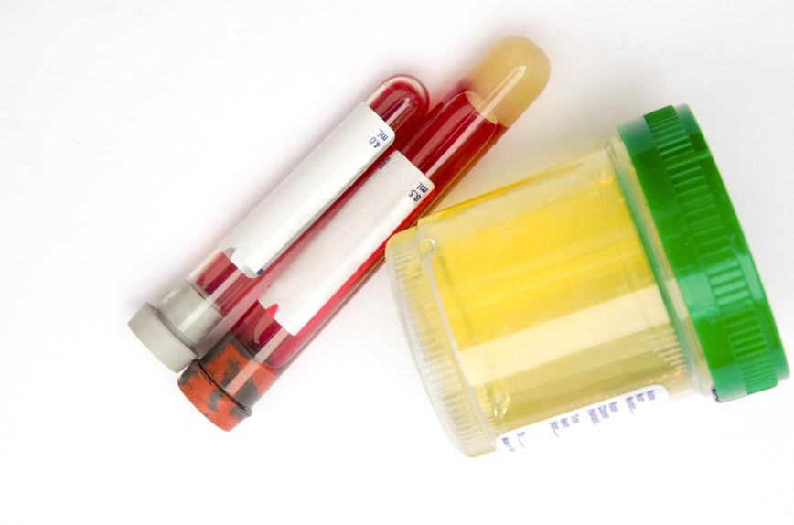
Testing for STIs
Blood test
Urine test
Physical exam
Swab/Smear
Notes:
The early detection and treatment of STIs is critical to prevent further spread if infections.
Testing and screening approaches differ by infection and sex.
The main testing/screening methods are:
Blood test: syphilis, genital herps, hepatitis B, HIV
Urine test: chlamydia, gonorrhea
Physical exam: HPV, trichomoniasis, public lice, scabies
Swab/smear: chlamydia, gonorrhea, syphilis, genital herpes, trichomoniasis, yeast infection, HPV

Slide 20
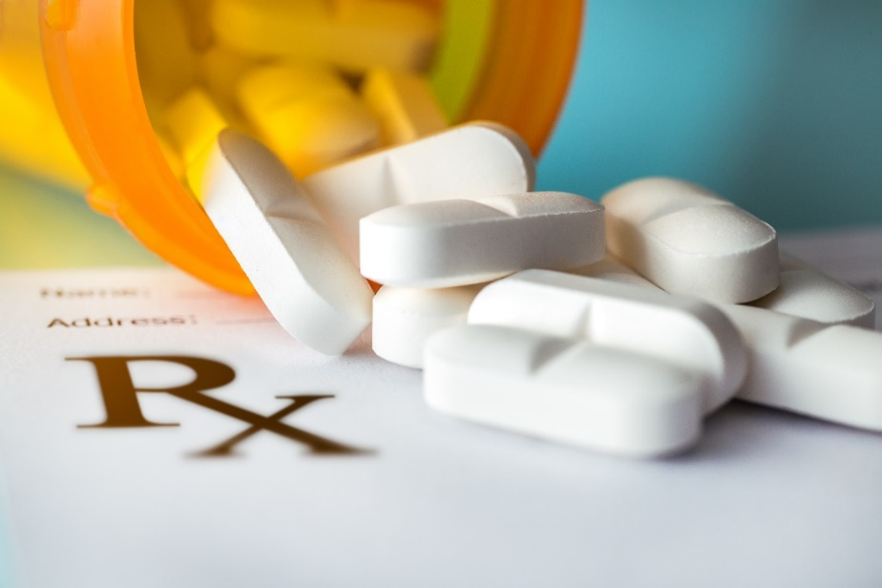
Treatments for STIs
Antibiotics
  Antibiotics, often in a single dose, can cure many sexually transmitted bacterial and parasitic infections, including gonorrhea, syphilis, chlamydia and trichomoniasis
Antiviral drugs
  If you have herpes or HIV, you'll be prescribed an antiviral drug.
Treatments to remove genital warts
Partners should be tested and treated too
Notes:
STIs caused by bacteria are generally easier to treat. Viral infections can be managed but not always cured.
Curable:
Chlamydia→ First line Tx: Azithromycin 1g PO x1 dose, Second like Tx: Doxycycline 100mg PO BID x 7 days
Gonorrhea→ First line treatment: Ceftriaxone 250mg IM single dose + Azithromycin 1g PO single dose. Second line treatment (only if first line tx contraindicated or unavailable. MUST be followed by test of cure)→ Cefixime 400mg PO single dose + Azithromycin 1G PO single dose
Syphilis→ benzathine penicillin G
Trichomoniasis “Trich”→ Metronidazole (Flagyl) 2g PO x1 dose
Antivirals
Herpes: Prescription medications for herpes: acyclovir, Valacyclovir (Valtrex) can reduce the severity and duration of symptoms. Treatment should be started as soon as possible and is most effective when started within the first 24 hours of the onset of symptoms. After the treatment of an episode of genital herpes, antiviral medications can also be used on a daily basis to prevent breakouts of genital herpes. This treatment, also referred to as suppressive therapy, is usually reserved for people who experience more frequent flare-ups (4 or more times per year) or are immunosuppressed.
https://www1.shoppersdrugmart.ca/en/health-and-pharmacy/conditions/genital-herpes/246/treatment-and-prevention
Genital warts treatment options:
Special medication can be used
Freezing with liquid nitrogen
Laser therapy to destroy the warts
Partners→ Partners should be tested and treated too. This prevents you from infecting your partner, or possibly being re-infected again if your partner is also infected. This helps prevent the spread of STIs
Avoid sex for 7 days→ The medication needs time to work to effectively kill off the bacteria (Chlamydia, Gonorrhea, Syphilis) This prevents you from infecting your partner and from being re-infected. Use condoms if you cannot wait 7 days. If you don’t use condoms and wait the 7 days, you’ll most likely need to be retreated again as you risked getting re-infected.

Slide 21
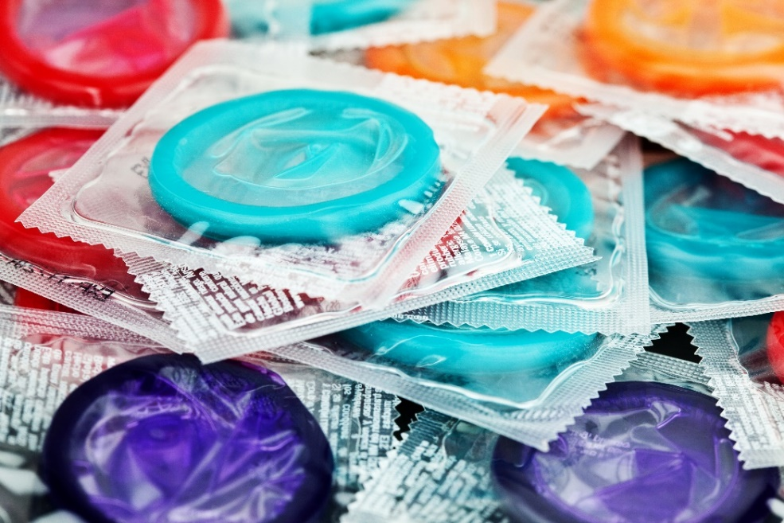
Preventing STIs
Abstinence
Practice safer sex
  Condoms
  Dental dams
Routine STI testing
Vaccinations
PrEP (HIV)
Open communication with your partner
Notes:
Abstinence→ The safest way to prevent STI. It’s okay to not have sex.
Routine Testing→ Q3-6 months or with each new partner. Makes you aware if you have an STI or not. Early treatment helps prevent complications (PID, Epididymitis) Helps prevent the spread of STIs
Vaccinations→ For HPV and Hep B “In Canada, HPV vaccination is approved for females from ages 9 – 45 and males from
ages 9 – 26.” https://www.sexandu.ca/stis/hpv/ “Vaccination works best before you are sexually active or have already become infected or exposed to an HPV virus, but can help reduce the risk of HPV-related disease at any time, even after an abnormal Pap test.” https://www.sexandu.ca/stis/hpv/
Get the HPV vaccine, ideally before you become sexually active
Still effective even if you have had sex already
Protects against 7 types of HPV that are associated with 90% of cervical cancers
Ontario vaccinates grade 7 students for hepatitis B and HPV
May be vaccinated for Hep B earlier if travelling to areas where Hepatitis A and B are common
Newborns born to infected mothers will get a Hepatitis B vaccine within 12 hours of birth
PrEP - Today, there are more options to reduce the risk of transmission of HIV. Consistently using condoms, taking Pre-Exposure Prophylaxis (PrEP) to help decrease the chance of acquiring HIV and knowing your HIV status are all effective strategies to reduce risk. PrEP, or Pre-Exposure Prophylaxis, is a highly effective way for people at high risk to have more control over their sex lives and protect themselves from HIV. PrEP involves taking one pill a day. The medication prevents the human immunodeficiency virus (HIV) from multiplying which means that, if you are exposed to HIV, PrEP makes it very difficult for the virus to infect your body. (https://ontarioprep.ca/)
In addition to other prevention strategies, pre-exposure prophylaxis (PrEP) is a highly effective HIV prevention strategy that is now available and being used in Canada. Health Canada has approved the use of oral PrEP to help prevent the sexual transmission of HIV, in combination with safer sex practices. To find out if PrEP is right for you, talk with your health care provider or call the Hastings Prince Edward Public Health Sexual Health Line at 613-966-5500 ext. 243.
Open communication→ Talk about the number of partners you have had in the past, be open if you have herpes. Go for testing together before engaging in sexuality activity and share your results. If you are old enough to have sex, you’re old enough to talk about sex with your partner. If you ever feel uncomfortable, say no, do not give your consent to have sex if you ever feel uncomfortable, not sure, not safe.

Slide 22
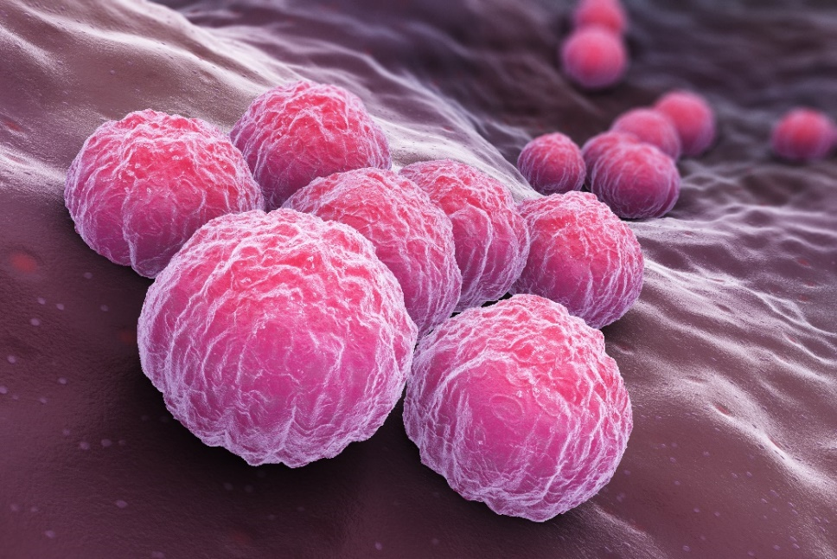
Bacterial
Chlamydia
The most common STI in Canada
Most cases in 15-24 year olds
Around 70% percent of women and 50% of men with chlamydia have no symptoms
Can infect the cervix, urethra, rectum, throat and eyes
Can be cured with antibiotics
Notes:
Most common bacterial STI in Canada
Symptoms:
Most people have no symptoms, but for those who do experience symptoms, they may include:
Itching, unusual discharge , pain or burning when going pee, sore throat (if contracted from oral sex). Infection can also spread to the eyes by touching an infected area and then touching the eye.
Women: pain in lower abdomen and bleeding between periods or during / after sex.
Men: pain or swelling of the testicles.
Symptoms may appear between 2 days to 2 weeks or longer after contact.
Spread:
Unprotected sexual intercourse (oral, vaginal & anal) by contact with infected partner.
Condom breaks
Test:
Usually: Pee in a cup (ask your school nurse about convenient way to be tested in your community/school)
Occasionally: Swab of cervix (Sexual Health Clinic, Dr.’s office / walk in clinic)
Treatment:
Antibiotics ( which are free, and available from your school PHN or the SHC and some walk-in clinics )
Possible complications if left untreated:
Infertility
Women : Chronic Pelvic Pain, Pelvic Inflammatory disease (PID), increased risk of ectopic pregnancy (pregnancy in the tubes).
Men: Infection in the tubes that carry sperm (epididymitis), swollen testicles
https://www.sexandu.ca/stis/chlamydia/

Slide 23
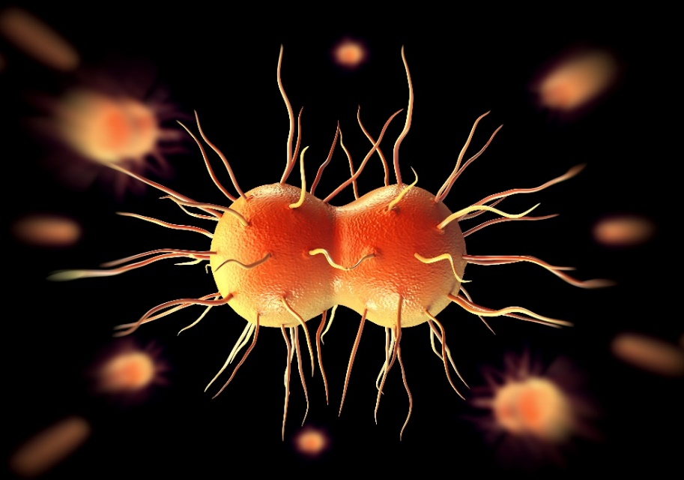
Bacterial
Gonorrhea
Second most common STI
Often a co-infection with chlamydia
Most cases in 15-29 year olds
Most women don’t have symptoms but most men will have symptoms
Can infect the cervix, urethra, rectum, throat and eyes
Can be cured with antibiotics BUT
Growing resistance to antibiotics
Notes:
2nd most common bacterial infection
Symptoms:
Most people have no symptoms, but for those who do experience symptoms, they may include:
Itching, unusual discharge, pain or burning when going pee, sore throat (if contracted from oral sex). Infection can also spread to the eyes by touching an infected area and then touching the eye.
Women: pain in lower abdomen and bleeding between periods or during / after sex.
Men: pain or swelling of the testicles.
Symptoms may appear between 2 days to 2 weeks or longer after contact.
Spread:
Unprotected sexual intercourse (oral, vaginal & anal) by contact with infected partner.
Condom breaks
Test:
Usually: Pee in a cup (ask your school nurse about convenient way to be tested in your community / school)
Occasionally: Swab of cervix (Sexual Health Clinic, Dr.’s office / walk in clinic)
Treatment:
Antibiotics ( which are free, and available from your school PHN or the SHC )
Possible complications if left untreated:
Infertility
Women : Chronic Pelvic Pain, Pelvic Inflammatory disease (PID), increased risk of ectopic pregnancy (pregnancy in the tubes).
Men: Infection in the tubes that carry sperm (epididymitis), swollen testicles
https://www.sexandu.ca/stis/gonorrhea/
Growing resistance to antibiotics→ This is why its important to help prevent the spread of STIs. Bacteria can develop resistance to antibiotics. If this happens, we can run out of treatment options. This means that there is a chance that one day gonorrhea won’t be cured with the antibiotics we use today.

Slide 24
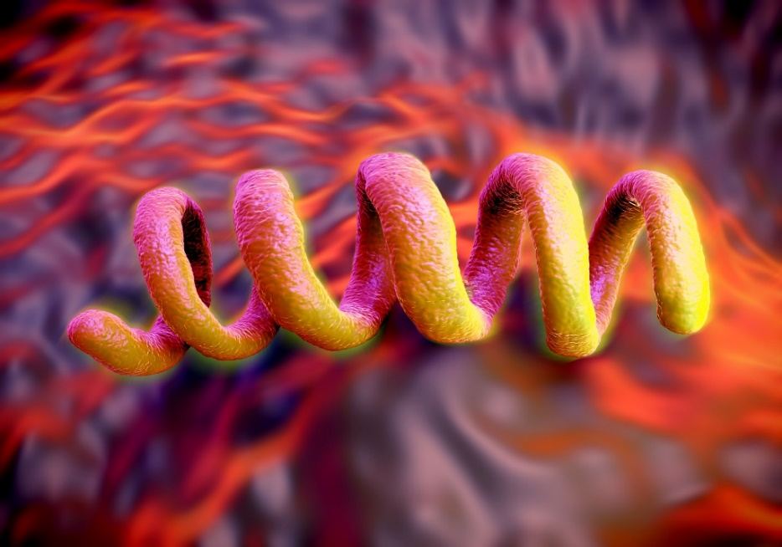
Bacterial
Syphilis
Rates in Canada are increasing
Most common in men who have sex with men
Painless sore
Can be fatal if left untreated
Can be cured with antibiotics
Notes:
Rates are increasing in Ontario . Most common in men who have sex with men. (transmitted through unprotected, oral, anal and vaginal sex)
Symptoms:
Primary: starts as a painless sore (ulcer) where the bacteria enters the body. You may not even realize you have this sore. This sore then heals and goes away in about 3-6 weeks.
Secondary: Skin rash, usually on the palms of the hands and soles of the feet, fever, lethargy, muscle aches, joint pain, swollen lymph nodes, vision changes, patchy hair loss
Tertiary: damage to the heart, lungs, brain (neurosyphilis).
Test: blood testing - at Sexual Health Clinic, Dr’.s office or walk in clinic.
Treatment: penicillin injections
https://www.sexandu.ca/stis/syphilis/

Slide 25
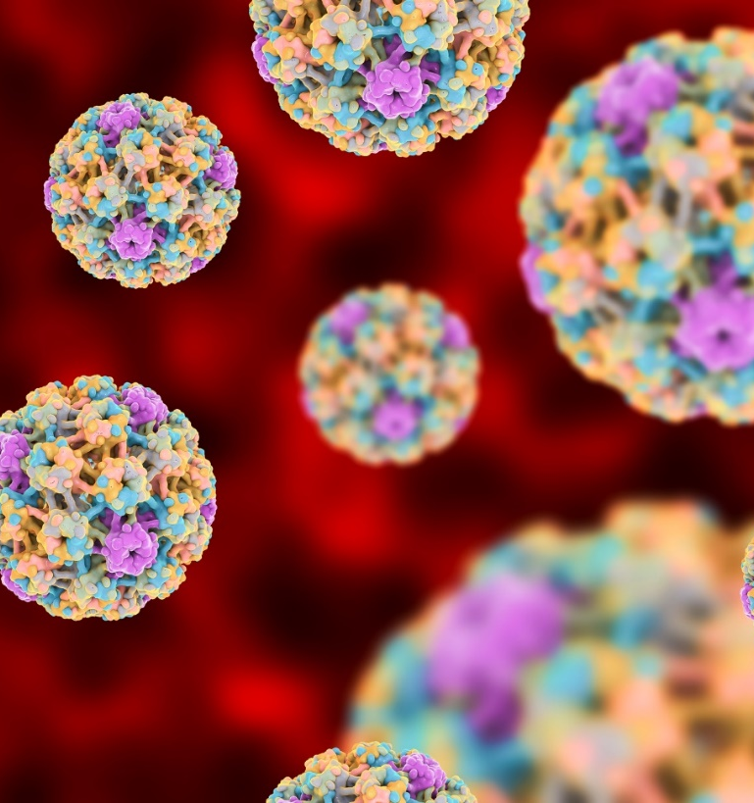
Viral
HPV
Human Papillomavirus
75% of Canadians will have at least 1 infection in their lifetime
Highest rates of infection are in ages 15-24
Single or clusters in genital warts
Soft, hard, round, flat, cauliflower-like
Many people have no symptoms of HPV
No cure for HPV
Notes:
Over 100 types of HPV – some can lead to cancer
Gardasil Vaccine protects against many cancer causing strains
Once infected this virus lives on the skin of the genitals
Symptoms:
Many people have no symptoms however others may develop genital warts within 1-8 months.
Warts can be single or found in clusters in and around the genital area (penis, scrotum, vaginal walls, cervix, vulva, anus)
Warts may be round, flat or cauliflower – like shaped bumps that are flesh / yellow/ gray coloured.
Itching bleeding/discomfort with sex – not painful (just like any other warts)
Spread:
Direct sexual contact (vaginal/anal). Intimate contact (genital rubbing). HPV can be spread through oral sex
Can be spread even if no warts are present
Condom may not fully protect you (WHY? – only covers the penis)
Test:
Checked by a Doctor or Nurse Practitioner if bumps are showing
Treatment:
There is no cure to eliminate HPV infection.
The good news is that most warts will go away by themselves over time.
For people who want treatment - a doctor or nurse practitioner may freeze the wart with sprays, or liquids depending on the type of wart and where it is. Sometimes a special cream can be ordered that helps the immune system fight HPV.
Most symptoms clear within 2 years
The warts can reappear
Important Information:
Avoid sex when tingling/burning starts until lesions have completely healed.
Currently, the Ontario Cervical Screening Program recommends that anyone with a cervix (women, transmasculine and non-binary people) who is or ever has been sexually active have a Pap test every 3 years starting at age 21.
Complications:
Re-occurrence, cancers, depression and sexual dysfunction
Prevention:
Gardasil Vaccine
Get the HPV vaccine, ideally before you become sexually active
Still effective even if you have had sex already or have already had an HPV infection
Protects against 9 types of HPV that are associate with 90% of cervical cancers
Gardasil 9 → HPV Vaccine offered at HPEPH. Most students get the HPV vaccination in grade 7. Check your vaccination record to see if you’re up to date with your vaccinations. You can call HPEPH and ask to speak to someone from the Vaccine Preventable Diseases Department.
What cancers does GARDASIL 9 help protect against?
GARDASIL 9 helps protect against certain cancers caused by 7 types of HPV:
Cervical cancer in womenª
Vulvar and vaginal cancers in womenª
Anal cancer in men and womenª
Certain head and neck cancers, such as throat and back of mouth cancers, in men and womenª
ªHPV Types 16, 18, 31, 33, 45, 52, and 58. https://www.gardasil9.com/adults/hpv-faq/
Most types of HPV are harmless, have no symptoms and go away on their own without treatment. https://myhealth.alberta.ca/sexual-reproductive-health/sexually-transmitted-infections/human-papillomavirus-(hpv)

Slide 26
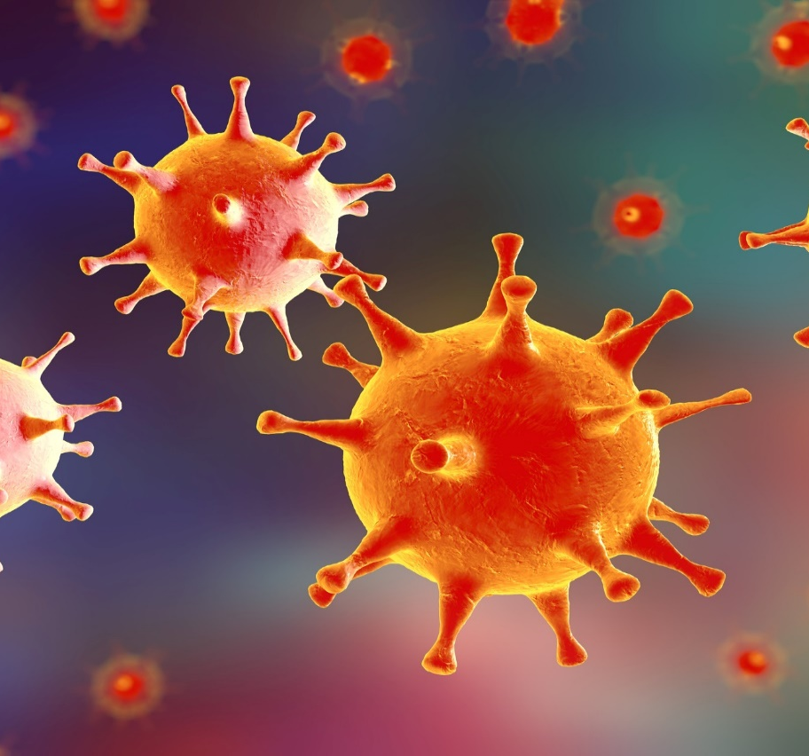
Viral
Caused by two types of the herpes virus
Herpes Simplex Type I (HSV-1)
  Associated with the oral infection
    Cold sores
Herpes Simplex Type II (HSV-2)
  Associated with the genital infection
  70% of HSV-2 infections happen when the infected person has no symptoms
Both cause sores on the lips (cold sores) and sores on the genitals
Not curable, but treatable
Herpes
Notes:
QUESTION: DID YOU KNOW THAT THERE ARE 3 DIFFERENT TYPES OF HERPES VIRUS. HERPES ZOSTER (Chicken Pox and Shingles) , HSV 1 AND HSV 2. TWO OF THESE ARE SEXUALLY TRANSMITTED
We are going to talk about HSV1 AND HSV2
.
HSV1 – Oral Herpes in the form of cold sores : may or may not be transmitted sexually (i.e. can get from kissing – even when grandma thanks you for your Christmas present)
HSV2 – Genital Herpes - always transmitted sexually
Once infected this virus can show on the skin of the genitals
Symptoms:
You may not know. Some people have the virus, but have no symptoms, and can pass the virus anyway (asymptomatic shedding)
Symptoms may start up to 3 weeks after having skin to skin contact with an infected person
Often the first infection is the worst
Blisters / sores
Rashes
Pain, tingling, itching
Aches and chills (flu-like symptoms)
Symptoms usually get better within 2 weeks
Spread:
Skin to skin contact
Can be spread even if no sores are showing
Condom /dental dam may not fully protect you
Infected pregnant women can pass virus to infants during birth. If you are pregnant and have genital herpes, please tell your health care provider.
Test:
Swab can be done when sores are showing
Treatment:
Anti-viral medication available to help lessen pain and shorten / prevent outbreak
This virus you have for life with periods of active and inactive “outbreaks”
After sores heal, recurrent outbreaks can occur – they can recur every month or every year (different for every person)
Outbreaks may be triggered by: stress, sex, menstrual cycle, exposure to sun, illness / fever, surgery, pregnancy and use of some medications
Prevention:
Condoms /dental dams have limited effectiveness at preventing infection as they don’t cover entire genital area.
If you have herpes wash hands well after touching any sores or blisters to prevent spreading to another person or another part of your body
Important Information:
If you give or get oral sex from someone who has oral herpes (cold sores) you can get the infection from them
- can be passed by receiving oral sex from a partner with a history of cold sores.
*Important to discuss history of cold sores with partner
*Outbreaks occur where virus first entered the skin
Transmitted through direct vaginal, oral or anal sexual contact with infected partner.
FYI ONLY: Health Risk
Pain and discomfort.
Emotional effects due to the on-going nature of the disease and the unpredictability of outbreaks.

Slide 27
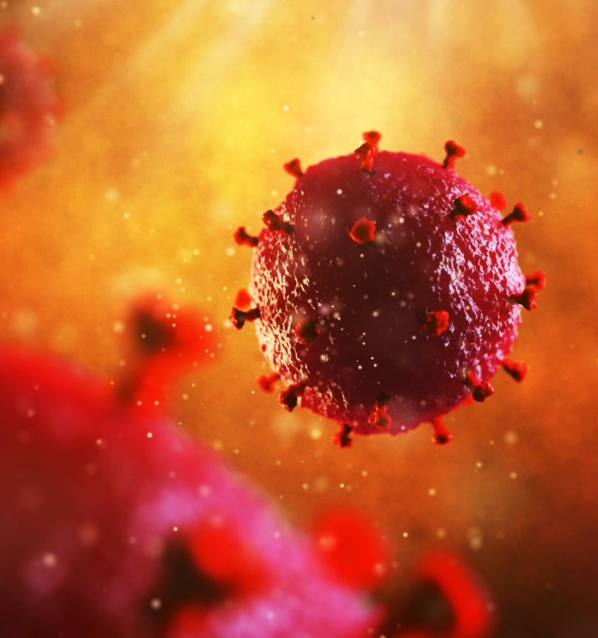
Viral
HIV (Human Immunodeficiency Virus)
A virus that weakens the body’s immune system
People can have HIV and have no symptoms
Pre-Exposure Prophylaxis (PrEP) – prevention strategy
No cure but there is treatment
  Considered a chronic disease
  Many people who have HIV live long lives
Can lead to AIDS if left untreated
Notes:
This virus lives in blood, semen, breast milk, and vaginal fluid
Symptoms:
Many have no symptoms
Some will have symptoms like fatigue, loss of appetite, night sweats, etc
50% of people infected with HIV will have flu like symptoms in the first 2-4 weeks.
Fever
Weight loss
Rashes
Muscle and joint pain
Nausea, vomiting and diarrhea
Oral and genital ulcers
Spread:
Unprotected oral, vaginal or anal sex with an infected partner (Sex without a condom or a condom breaks)
Direct contact with infected blood (sharing needles, drug equipment)
Test:
Window Period: HIV may take 12 weeks to show in the blood
Test will only be accurate if taken 12 weeks after last high risk activity
Blood test
Treatment:
No cure,
Drugs are available that can control HIV infection to keep you healthy longer
Prevention:
ALWAYS use a condom
Do not share needles or other objects that may contain infected blood (razors, toothbrushes etc.)
Pre-Exposure Prophylaxis (PrEP)
Today, there are more options to reduce the risk of transmission of HIV. Consistently using condoms, taking Pre-Exposure Prophylaxis (PrEP) to help decrease the chance of acquiring HIV and knowing your HIV status are all effective strategies to reduce risk.
In addition to other prevention strategies, pre-exposure prophylaxis (PrEP) is a highly effective HIV prevention strategy that is now available and being used in Canada. Health Canada has approved the use of oral PrEP to help prevent the sexual transmission of HIV, in combination with safer sex practices. To find out if PrEP is right for you, talk with your health care provider or call the Hastings Prince Edward Public Health Sexual Health Line at 613-966-5500 ext. 243.
CD4+ T Lymphocytes → Helper T Cells “A type of lymphocyte. CD4 T lymphocytes (CD4 cells) help coordinate the immune response by stimulating other immune cells, such as macrophages, B lymphocytes (B cells), and CD8 T lymphocytes (CD8 cells), to fight infection. HIV weakens the immune system by destroying CD4 cells.” https://clinicalinfo.hiv.gov/en/glossary/cd4-t-lymphocyte
AIDS→ Acquired immunodeficiency syndrome. The advanced stage of HIV. AIDS is fatal, not HIV.
HIV is not spread
Shaking hands, working with or eating with someone who has HIV
Hugs or kisses
Cough, sneezes or spitting
Swimming pools, toilet seats or water fountains
Insects or animals
Blood transfusions*
*Blood transfusions*: “Since November 1985, all blood products in Canada are checked for HIV, to ensure that it is safe to get a blood transfusion. And there is no chance of getting HIV from donating blood.
HIV and sex” https://www.catie.ca/en/basics/hiv-and-aids#what
https://www.sexandu.ca/stis/hiv/
https://www.catie.ca/en/basics/hiv-and-aids#what

Slide 28
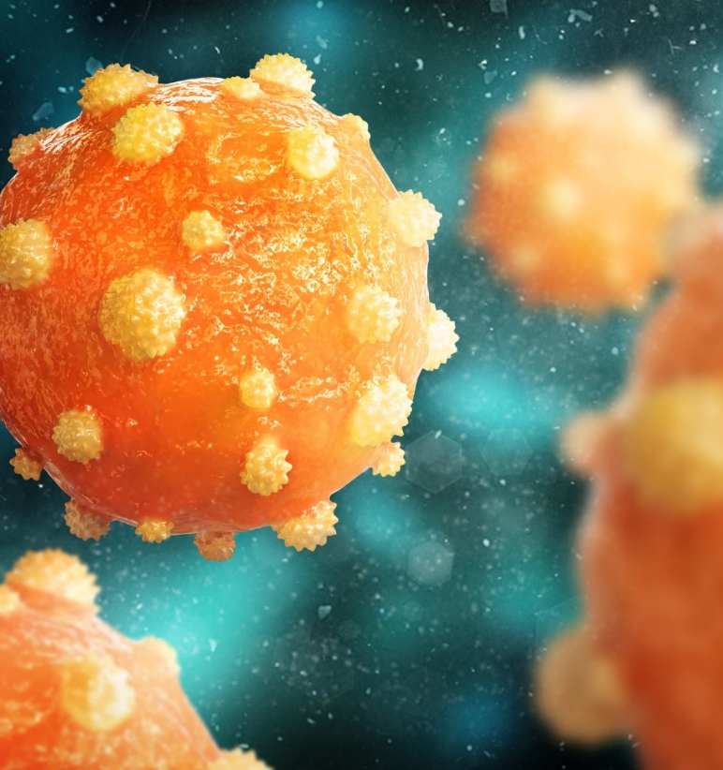
Viral
Hepatitis B
A virus found in blood and bodily fluids like semen, vaginal fluids and breastmilk
Commonly referred to as Hep B
It affects the liver
Preventable by vaccination
No cure
Notes:
50-70% of people will have no symptoms
8 weeks after exposure some people may have the following symptoms
Flu like symptoms such as being tired, nausea and vomiting
Decreased appetite
Rash
Joint pain
Jaundice (yellowing of the whites of the eyes and skin) *rare*
If left untreated can:
Lead to severe liver damage called cirrhosis which scars the liver
Liver cancer
A complicated blood vessel disease that affects the liver, stomach, intestines and pancreas
https://www.sexandu.ca/stis/hepatitis-b/

Slide 29
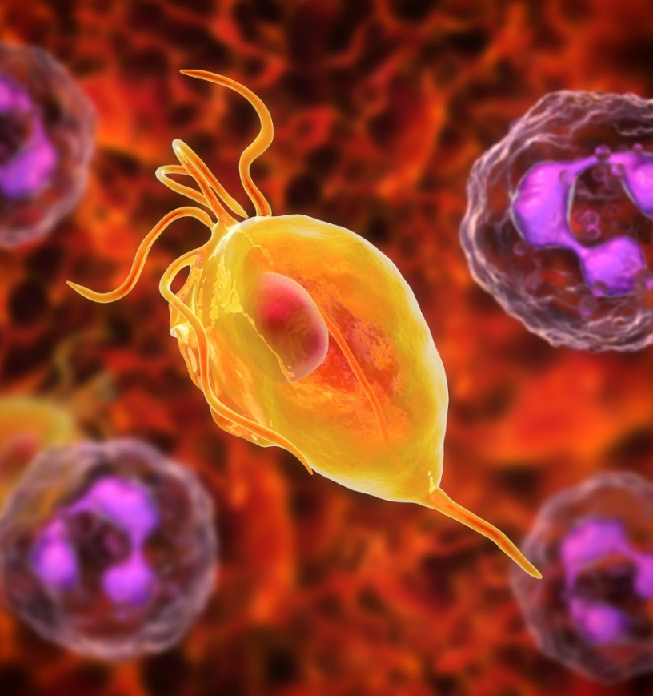
Parasitic
Trichomoniasis
Cause by a parasite called Trichomonas vaginalis
Also known as “Trich”
Affects the urethra, bladder, vagina, cervix and under the foreskin of the penis
10-50% of people who are infected have no symptoms
Curable with antibiotics
Notes:
Trichomonas is a parasitic infection of the penis or vagina.
Symptoms:
Grey, yellow, or green discharge from vagina or penis
Discharge may be thin, bubbly and smell bad
The vagina or penis may be red, itchy or sore
Pain with sex and / or peeing
Spread:
It is usually caused by having sex with someone who has it.
It can live on wet objects such as towels and washcloths
Test:
Physical exam including vaginal swab
Treatment:
Antibiotics (which are free, and available from your school PHN or the SHC)
Partners need to be treated at the same time
Do not share towels while being treated
https://www.sexandu.ca/stis/trichomoniasis/

Slide 30
Key Messages
A quick reminder
Open communication with your partner
Abstinence
Practice safer sex
  Condoms
  Dental dams
No symptoms, does not mean no STIs
Routine STI testing
Vaccinations
Notes:
Open communication with your partner→ Be open with your partner if you’re practicing abstinence or not ready to have sex. If you are old enough to have sex, you’re old enough to talk about sex with your partner. If you ever feel uncomfortable, say no, do not give your consent to have sex if you ever feel uncomfortable, not sure, not safe. Be open about going for testing for STIs or if you have herpes with your partner. Open communication is part of a healthy relationship.
Abstinence→ It is okay to abstain from sex and wait until you are ready. Abstinence is the safest way to prevent STIs and pregnancy.
Practice safer sex→ Use condoms and dental dams. If money is a concern, HPEPH offices give out condoms for free; including latex free condoms.
No symptoms, does not mean no STIs→ Remember, you can still be infected with an STI and have no symptoms. No symptoms does not necessarily mean you do not have an STI.
Routine STI testing→ it is recommended to get testing done; with each new partner you have as well as routine testing (every 3-6 months), You can seek testing through your family doctor, a walk in clinic or call HPEPH sexual health line for assistance.
Vaccinations→ Vaccines can help prevent illness and disease. Call HPEPH to see if your vaccination record is up to date.

Slide 31
Contacts
Where to go for more information or help
Hastings Prince Edward Public Health
  https://hpepublichealth.ca/
  613-966-5500 extension 418
Sex and U
  https://www.sexandu.ca/
Sexual Health Ontario
  https://sexualhealthontario.ca/en/home
  1-800-668-2437
  Online chat that runs Monday to Friday
Notes:
HPEPH: Sexual Health Phone line runs Monday to Friday 9am-4pm. If your school has a Public Health Nurse, you can connect with them as well during clinic hours.
Sex and U: Evidence based information ranging from STIs, your body, consent, sexual activity, LGBTQ+, Contraception and pregnancy from The Society of Obstetricians and Gynecologists of Canada
Sexual Health Ontario: Evidenced based information on sexual health, reproductive health and STIs. You can chat with a counsellor on the phone Monday to Friday 10am to 10:30pm. Saturday to Sunday from 11am to 3pm. There is also an online chat that runs Monday to Friday 10am-5pm.

