Slide 1
Contraception (Birth Control)
Notes:
Notes to presenter:
-this presentation directly supports the H&PE Curriculum, Healthy Living Strand, in Grade 7 D1.3 Delaying sexual activity, D1.5 STBBIs and pregnancy prevention, D2.4 Sexual health and decision making, Grade 8 D1.4 Decisions about sexual activity; supports, D2.3 Decision making consideration and skills, Grade 8 C1.4 Decision about sexual activity; supports, C2.4 Decision making, contraception, Grade 9 C1.4 Preventing pregnancy and STIs (could also be used for higher grades (7+)).
Before presenting to students, please review content in advance with classroom teacher or other school staff to ensure appropriateness.
-provide a “sensitive topic” statement and make students aware of supports available in school (e.g. have social worker on standby/available for drop ins, Guidance, trusted adult)
______________________________________________________
Sample Speaker Notes:
-Welcome & Introduction
-Today we will be talking about Contraceptives (Birth Control) options
-If you feel that you need advice, please talk to a teacher, parent, school social worker or other adult you trust.
-We won’t address individual situations during the presentation (privacy) but you can speak to someone after if you like.

Slide 2
The Genderbread Person
Notes:
No one type of relationship is ‘normal’ – but all relationships deserve respect.
Gender identity is what gender you identify with, and how you express your gender to the world.
People who’s gender identity does not match their reproductive organs are considered transgendered, meaning that they identify with a gender that is different from their biological sex.
Some people may have sexual organs or hormones from both sexes; this is called being intersex.
Gender expression is how you express your gender to the world – through things like how you dress, act, and behave
Biological sex is the sex organ you are born with. Some people are born with organs or hormones from both sexes – this is called being intersex.
Sexual Orientation is who you are attracted to physically, spiritually, and emotionally. This may include being attracted to someone of the same or opposite sex as you. This may also include being attracted to both sexes.
Some sexual orientations you will identify with, and some you will not.
Regardless of your own sexual orientation, you will go to school, work, and be friends with people who may identify with a different sexual orientation then yourself.
We all need to be able to respect every person we come into contact with, regardless of their sexual orientation.

Slide 3
Contraception
Notes:
Why is it important to learn about contraception?
Teaching about contraception is not an assumption that students in class are sexually active. In fact, by the time they finish high school less than ½ of students will have had sexual intercourse. Factual information, however, is critical to make healthy decisions now and in the future.
Adolescence is a time of change and experimentation with regard to everything from hairstyles to sexual expression. Teens are encouraged to feel independent, strong and mature in terms of decision-making.
Deciding when to have sexual intercourse is different for everyone. There is no "magical" age when someone is ready to have sex. There is no natural time in a relationship to start having sex, and there is no rule which says you must have sex with someone, even if you have been dating for a long time.
Sex should be a joyful, comfortable and guilt-free experience for both you and your partner. Respect yourself and know what you want. Remember, you always have the right to say "No" to sex, even if you have said "Yes" before!
What is the same for everyone, though, is that once a couple decides to have sexual intercourse there are consequences – and pregnancy is one of the most preventable consequences – by learning about and using contraceptives correctly.
OPTIONAL: CONTRACEPTION TEACHING KIT CAN ACCOMPANY PRESENTATION AS A VISUAL AID

Slide 4
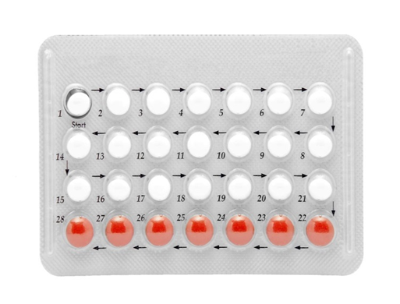
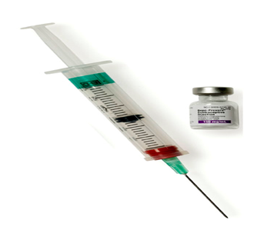
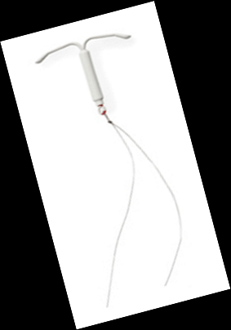
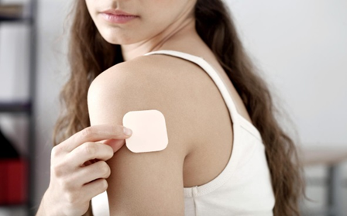
What is Contraception?
Notes:
Ask: What is contraception?
Answer: Methods to prevent pregnancy
Contraception, also known as birth control, is used to prevent pregnancy. There are many different birth control methods to help you and your partner prevent an unplanned pregnancy.
In this presentation, we review the common methods that are available to help you understand the options and help you narrow down the choices now or in the future.
Talk over your choices with your health care provider to choose the method that is best for you.
If you identify as transgender, you may have specific reproductive concerns and may wish to consult an LGBT-friendly health care provider.
In this presentation, we use “sex” to refer to sexual intercourse, vaginal intercourse or frontal sex. We also use vagina, penis and breast. Some people use other words to suit their identities and culture. We respect the use of other words.

Slide 5
Safe Sex
Sex can be fun and pleasurable. However, worrying about the risk of unplanned pregnancy and sexually transmitted infections (STIs) may make it harder to enjoy sex
Using contraception is important to help prevent unplanned pregnancy and STIs
Condoms are the only method of contraception that protect against both unplanned pregnancy and STIs, including HIV

Slide 6
Contraception Discussion
Activity
Think about the following questions:
What is it?
How does it work?
Why would someone choose this method?
Cost/where can you get it?
Notes:
OPTIONAL: CONTRACEPTION TEACHING KIT CAN ACCOMPANY PRESENTATION AS A VISUAL AID
Hand out birth control samples and have students try to answer the following questions.
Give student 5-10 minutes to complete the activity.
Have one student record the answers and one student present at appropriate time during presentation.
As HP/PHN/Educator goes over each type of contraception in the presentation….ask the class who had__________ ( i.e. condoms, contraceptive pill, abstinence) and have them report back to the class before presenting the information in the slides.

Slide 7
Abstinence
100% effective
Notes:
What does Abstinence mean to you?
There are differing views on the definition of abstinence.
Discuss setting limits. Ask class to describe what this means.
People have to set limits for themselves, and communicate those limits to their partner.
This is the only 100% proven effective option for contraception. It is a great method for the beginning stage of a relationship to test understanding and feelings for each other.
There must not be any skin to skin contact in the genital area to be confident about pregnancy prevention and to prevent sexually transmitted infections.
When practicing oral sex, remember that mouth to genital contact can lead to sexually transmitted infections.
Also remember that sperm can travel and they have the ability to find their way into the vagina if ejaculation takes place at the entrance of the vagina. Be sure to keep a condom available, just in case you may need it.
NB : Abstinence is only 100% effective against pregnancy and STIs if there is NO sexual behaviour including skin to genital contact, genital to genital contact or exchange of bodily fluids.
Why is abstinence a good choice?
Effective protection from STIs and pregnancy.
Not ready for sex or not interested in the stress that is involved in having intercourse at an early age.
Wanting to spend time on other things; being focused on personal goals; sports, friends and to focus on personal growth
Religious beliefs, cultural beliefs; self-worth.

Slide 8
Barrier Contraceptive Methods
Notes:
Barrier methods of contraception work by creating a physical barrier between sperm and egg cells so that fertilization cannot occur. They also protect against STIs

Slide 9
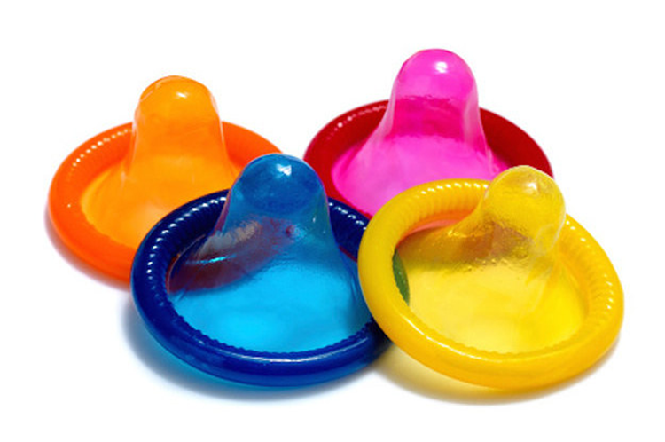
Male/External Condoms
97% effective when used properly
Use before ANY genital contact
Protection against some STIs
Notes:
What is it?
The condom is a latex cover which fits over the erect penis and prevents direct contact between the penis and vagina
How does this method work?
It is a barrier method - prevents sperm from getting into the vagina and fertilizing the egg.
Why would someone choose this method?
Easy to get, no prescription needed, not expensive.
Reversible method
Only method, besides abstinence, that offers contraception and STI prevention for oral sex and intercourse.
Comes in different sizes, colours, flavours
97% effective when used properly
Cost
Ask your school nurse how to access condoms for free!
IF YOU HAVE A LATEX ALLERGY: Polyurethane latex free condoms can also be provided for free. Ask your school nurse!

Slide 10
Using a Condom
Notes:
https://www.youtube.com/watch?v=fbo9_0IgcFA
Video
Although most people think using a condom is fairly straight forward, failure rates from condoms are often related to improper use.
If comfortable, you can do a condom use demonstration with penis demonstrator. Otherwise show this video.

Slide 11
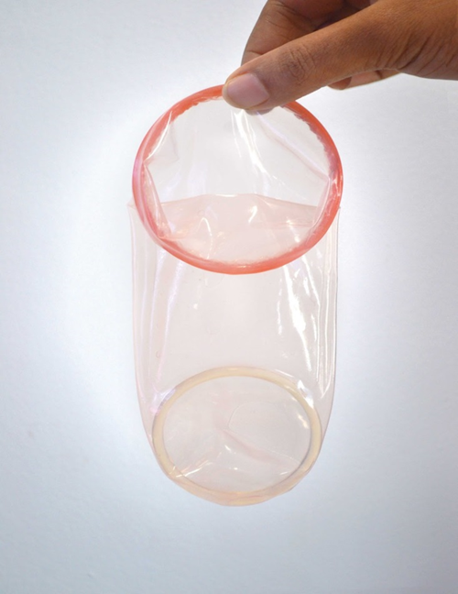
Female/Insertive Condoms
95% effective with proper use
Use before ANY genital contact
Protection against some STIs
Notes:
What is it?
A polyurethane cover that lines the inside of the vagina and covers the genitals.
How does this method work?
Placed in vagina prior to vaginal intercourse (up to 8 hours prior)
It is a barrier method – it prevent sperm from getting into the vagina and fertilizing the egg cell.
Why would someone choose this option?
Free from school nurse
Approximately $3.00 each when purchased at a pharmacy,.
Reversible method of contraception
95% effective when used perfectly every time
Most people do not use perfectly every time, so with average use, they are 79% effective
Protects against STIs
Cost
Ask your school nurse how to access condoms for free!

Slide 12
Hormonal Contraceptives
Notes:
Medications containing hormones such as estrogen and progesterone that females take to prevent pregnancy
Hormonal contraceptives are prescribed by a doctor or nurse practitioner who do a thorough health history and an assessment to determine the best option for the patient.
Mild side effects are possible with all hormonal methods: breast tenderness, spotting, etc.
In rare cases, a girl may experience a severe reaction to hormonal contraceptives.

Slide 13
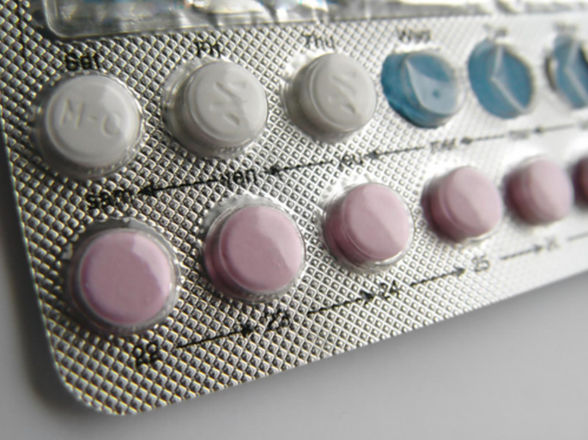
Oral Contraceptives
99% effective with perfect use
Take at the SAME TIME every day
No protection against STIs
Notes:
What is it?
Oral contraceptives (also called ‘The Pill’) are hormone pills that prevent pregnancy when taken correctly. There are many different types of pills. The right one will be chosen for you by having a discussion with your health care provider.
What you need to know?
Contains hormones that stop ovulation (monthly egg release).
Changes cervical mucous, making it difficult for sperm to travel
Must be taken every day at the same time.
Why would someone choose this option?
99.9 % effective if taken properly ( Describe proper / perfect use means taking every day at the same time , as prescribed by a doctor or nurse practitioner. Usual use effectiveness is 92-97% - i.e. errors made by forgetting pills, not taking at the same time every day etc.)
Can help regulate periods and help with cramps
Can also improve acne
Cost
Ask your school nurse how to access for free or reduced cost. Some are covered by OHIP+
The pill does not offer any protection against STIs so it is important to use a condom with all sexual activity.

Slide 14
EVRA Patch
99% effective with perfect use
Change weekly for 3 weeks
No protection against STIs
Notes:
What is it?
Evra is a patch that is placed on the skin and releases hormones through the skin
How does this method work?
Evra works like the Birth Control Pill except the hormones are absorbed through the skin instead of the stomach lining
Each box of Evra contains 3 patches. A patch is applied once a week for three weeks on the SAME DAY of the week. The fourth week is a patch free week and this is when a girl’s period would start. After the fourth week, a new patch is applied. It is important to remember to apply the patch on the same day at the same time every week. For example, someone may choose to change their patch every Sunday at 5pm.
The patch is placed on the buttocks, upper outer arms, lower stomach or shoulder blade (not breasts).
Why would someone choose this option?
Don’t have to take daily – only change once a week
99 % effective if taken properly
Can help regulate periods and help with cramps
Can also improve acne
Cost
Ask your school nurse how to access for free or reduced cost. Covered by OHIP+
The patch does not offer any protection against STIs so it is important to use a condom with all sexual activity.

Slide 15
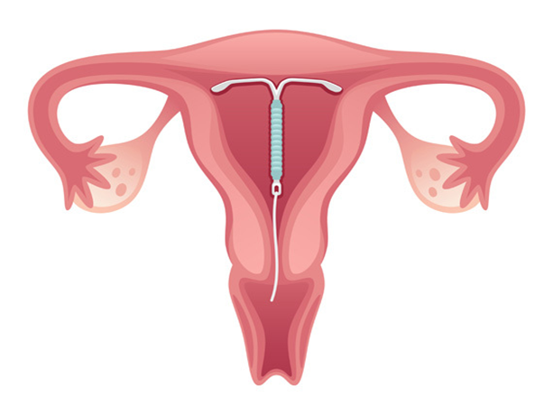
Hormonal Intrauterine System (IUS)
99.9% effective
Inserted by doctor – good for 3 to 5 years
No protection against STIs
Notes:
What is it?
A T-shaped device inserted into the uterus by a doctor or specially trained nurse practitioner
Lasts 3-5 years depending on the type
Contains the hormone progestin, which changes the lining of the uterus to stop a fertilized egg from growing inside the uterus, thickens the mucous in the cervix so it’s harder for the sperm to get to the egg, slows the sperm movement. May stop the ovaries from releasing an egg
Why would someone choose this option?
Long-acting and you only need to think about it when the 3 - 5 years is up
99% effective
Can reduce bleeding and cramping
Cost?
Ask your school nurse how to access for free or reduced cost.
The IUS does not offer any protection against STIs so it is important to use a condom with all sexual activity.

Slide 16
Depo - Provera
99.7 % effective
Given by needle every 12 to 13 weeks
No protection against STI
Notes:
What is it?
Depo-Provera™ is a hormonal birth control method that contains only a progestin. (no estrogen) It is given by injection every 12 -13 weeks.
What you need to know?
Contains hormones that stop ovulation (monthly egg release)
Changes cervical mucous, making it difficult for sperm to travel
Injections are given by a health care provider. A prescription is required.
The first injection should be given during the first 5 days of the menstrual cycle.
It becomes fully effective 24 hours after the first injection
Injections must be given every 12-13 weeks
If late for an injection, a pregnancy test should be done before another injection is given. A non-hormonal method of birth control ( i.e. condoms) should be used until next injection is given and for 3 weeks after that injection
Why would someone choose this option?
99.7 % effective if taken properly
Do not have to think about birth control every day – only 4 times a year!
Many women stop having periods within the first year of taking depo-provera (this is not unhealthy – may be a positive side effect for women with painful periods)
Can be used by breastfeeding mothers – no effect on breast milk production
Side Effects
The most common side effects are irregular bleeding and weight gain, although they do not happen to every user.
Irregular bleeding is common in the first few months of use. Some women have no bleeding; some women have spotting, and some women experience heavier bleeding. The bleeding usually decreases with time. By one year, 50% of women will stop having periods altogether.
Women may gain weight with the average gain in the first year being approximately 5-10 pounds. This may be due to increased appetite and an increased food intake. Not all women gain weight and healthy diet and exercise are important for all women.
There may be a small decrease in bone density in women who use the injection especially teens. There is no evidence that this will lead to osteoporosis. Bone density appears to return to normal when the injections are stopped, but there is no guarantee. Studies are ongoing. It is always important for a woman to have a calcium-rich healthy diet and active lifestyle.
A woman's return to fertility with this method can be longer than with the oral contraceptive pill. It takes an average of 9 months after your last injection to return to your regular menstrual cycle pattern. In some women, this can take longer, but Depo Provera does not cause infertility.
Cost
Ask your school nurse. Covered by OHIP+
Depo-Provera does not offer any protection against STIs so it is important to use a condom with all sexual activity.

Slide 17
Contraceptive Implant
99.95% effective
Inserted by health care provider – good for up to 3 years
No protection against STIs
Notes:
What is it?
The contraceptive implant is a contraceptive method that was approved for use in Canada in May 2020. It has been used in many other countries, including the United States, for many years. It is a 4cm long and 2mm wide flexible rod that sits just below the skin and continuously releases a progestin hormone into the bloodstream. It is inserted in the office by a health care provider using local anaesthetic to numb the skin and provides reversible and highly effective birth control for up to three years by preventing ovulation.
How does it work?
The implant is placed by a health-care professional in the upper inner arm just below the skin. The procedure is fairly simple and takes only a few minutes. It is done using local anaesthesia (“freezing”) to numb the skin. Once it is placed, the implant is not visible but can be felt just under the skin. The implant provides highly effective birth control for up to three years. At that time, the implant can either be removed or replaced.
The progestin hormone prevents the ovaries from releasing an egg. It also thickens the cervical mucus making it difficult for sperm to reach the egg.
Why would someone choose this option?
The contraceptive implant is one of the most effective methods of contraception available. 99.95% effective
Long term, forgettable, and discreet (up to 3 years)
May be suitable for women who cannot take estrogen
May be suitable for breastfeeding women
May be suitable for women over the age of 35 who smoke
Reduces menstrual cramps and PMS
Reduces or eliminates periods
Side Effects
Initially irregular bleeding is the most common side effect
Cost?
Ask your school nurse how to access for free or reduced cost. Nexplanon covered by OHIP+
The Contraceptive implant does not offer any protection against STIs so it is important to use a condom with all sexual activity.

Slide 18
Other Forms
of Contraception

Slide 19
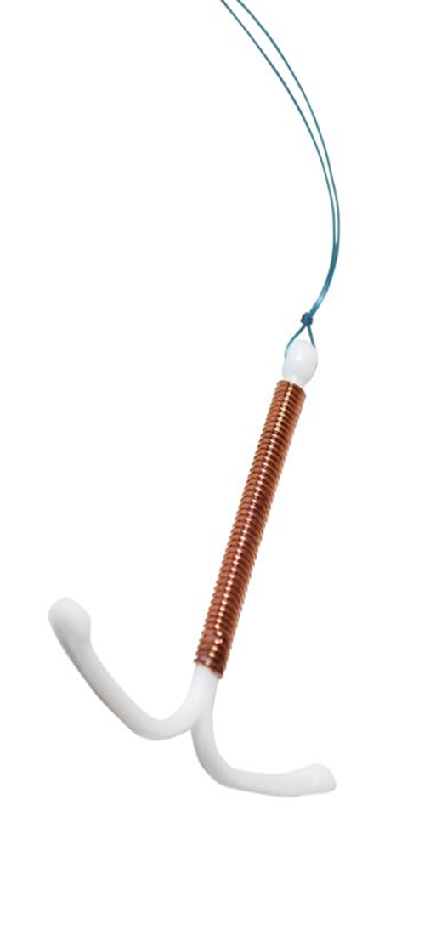
Copper Intrauterine Device (IUD)
99% effective
Inserted by doctor – good for 3 to 5 years
No protection against STIs
Notes:
What is it?
A T-shaped piece of plastic and copper inserted into the uterus by a doctor or specially trained nurse practitioner
Inserted every 3, 5 or 10 years depending on the type
The copper changes the chemistry of the uterus and stops sperm from fertilizing an egg
Why would someone choose this option?
Is a non-hormonal method. A good alternative for women who can’t use hormonal contraceptive methods. (i.e. migraines with aura)
Long-acting and you only need to think about it when the 3+ years is up
99% effective
Can be used up to 7 days after unprotected sex for emergency contraception
Cost?
Ask your school nurse how to access for free or reduced cost.
The IUD does not offer any protection against STIs so it is important to use a condom with all sexual activity.
The IUD may be more expensive than other methods initially, but will save you money in the long run

Slide 20
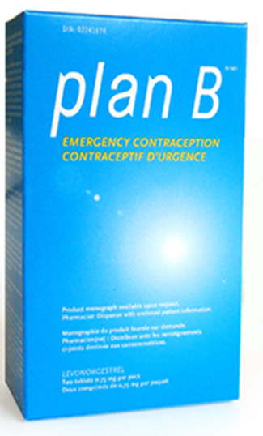
Emergency Contraceptive
Used after unprotected sex to prevent pregnancy
Can be taken up to 120 hours (5 days) after sexual encounter
Not to be used as regular birth control
Notes:
What is it?
A hormone pill that can lower the risk of pregnancy after there has been unprotected sex, a condom breaks or another method of contraception has not been used properly / as prescribed. Women should not rely on EC as your primary method of birth control.
How do they work?
It functions by delaying or inhibiting the release of an egg (ovulation)
ECPs do not cause abortion of an existing pregnancy.
Is most effective the sooner it is taken to the time of unprotected intercourse: 95% when taken within 24 hours, 85 % when taken within 25-48 hours, 58% when taken between 49-72 hour, less than 58% when taken between 73-120 hours)
A woman may experience spotting (light vaginal bleeding) a few days after taking Plan B and her next period may be heavier than normal
There is still a risk of pregnancy – if a woman doesn’t get a period within 3 weeks they need to have a pregnancy test.
Cost at SHC / School Nurse
Ask your school nurse how to access for free. Some local pharmacies for free. In some cases covered by OHIP+
Why would someone choose this option?
A simple and safe way to prevent pregnancy
ECPs have no known medically serious complications
ECPs do not appear to be harmful if inadvertently taken in pregnancy.
Available without a prescription at pharmacies
You can obtain the product in advance and store it for use in case of an emergency.

Slide 21
Condom Activity - Optional
Activity
Divide class into 5 groups
Provide each group with wooden penis model
Demonstrate to class how to properly put on a condom
Have groups practise putting condom on wooden penis model
Notes:
OPTIONAL: CONDOM DEMONSTRATION TEACHING KIT CAN ACCOMPANY PRESENTATION AS A VISUAL/SKILL BUILDING AID
Ensure each group has a wooden penis model and enough condoms for each student to have a turn.
Some students may not feel comfortable with this activity and can pass.

Slide 22
More Information
For more information about sexual health, ask a health care provider, your school public health nurse, or visit a sexual health clinic at a public health office.
Discussions are confidential
Respectful
Non-judgmental
Confidential
A positive space for 2SLGBTQI+ persons
Notes:
Two places you can access sexual health information and services - the public health nurse at your school or a sexual health clinic at a public health offer free and confidential services including: birth control, STI testing and free treatment, pregnancy testing/counselling and referral, emergency contraceptive methods, HIV testing and free condoms.

Slide 23
Questions?
itsaplan.ca
sexandu.ca

