Slide 1
Reproductive System Review
Notes:
Notes to presenter:
-this presentation directly supports the H&PE Curriculum, Healthy Living Strand, in Grade 7 D1.3 Delaying sexual activity, D1.5 STBBIs and pregnancy prevention, D2.4 Sexual health and decision making, Grade 8 D1.4 Decisions about sexual activity; supports, D2.3 Decision making consideration and skills, Grade 8 C1.4 Decision about sexual activity; supports, C2.4 Decision making, contraception, Grade 9 C1.4 Preventing pregnancy and STIs (could also be used for higher grades (7+)).
Before presenting to students, please review content in advance with classroom teacher or other school staff to ensure appropriateness.
-provide a “sensitive topic” statement and make students aware of supports available in school (e.g. have social worker on standby/available for drop ins, Guidance, trusted adult)
______________________________________________________
Sample Speaker Notes:
-Welcome & Introduction
-Today we will be reviewing the reproductive systems
-If you feel that you need advice, please talk to a teacher, parent, school social worker or other adult you trust.
-We won’t address individual situations during the presentation (privacy) but you can speak to someone after if you like.
A person’s sex can be assigned at birth as male or female. Some people are born as intersex (the reproductive, sexual or genetic biology of a person is unclear, not exclusively male or female or otherwise does not fit within traditional definitions of male or female). Assigned sex is independent of gender.
Gender identity is a person’s internal sense of identity as girl/woman, boy/man, fluid among genders or no gender (regardless of what sex they were assigned at birth).

Slide 2
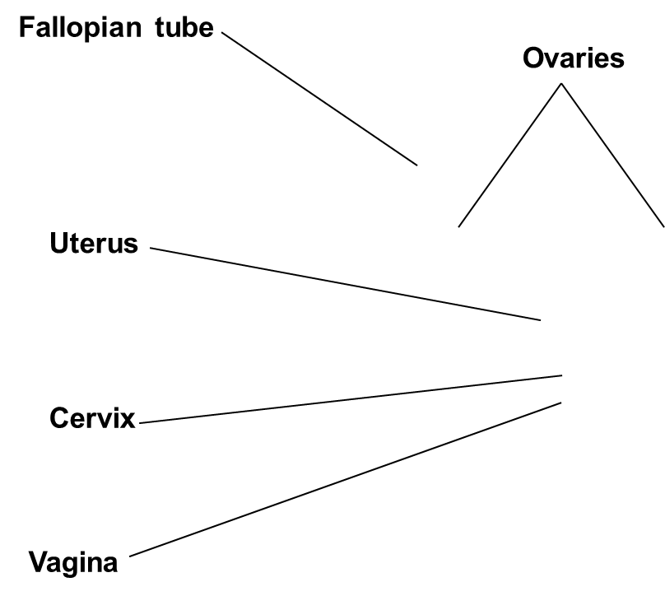
Reproductive System
Notes:
Review of reproductive systems.
People with a vagina (female) reproductive system have organs both inside and outside the body. The internal organs include the fallopian tubes, ovaries, uterus, and cervix. The external organs include the vagina, vulva and the clitoris (part of the vulva).
Fallopian Tube – Fallopian tubes connect the ovaries to the uterus, creating a passageway for the eggs to be transported from the ovaries to the uterus. If a sperm fertilizes the egg, it is at this point that pregnancy can occur.
Ovaries – Ovaries are the main reproductive organ of females. They produce female hormones and eggs.
Uterus – The uterus connects all the female organs and it is there that a baby develops during pregnancy. Pregnancy lasts 280 days on average.
Cervix – The cervix is the neck of the vagina.
Vagina – The vagina is a muscular tube leading from the external genitals to the cervix. Menstrual blood leaves the body through this passageway. A penis is inserted into the vagina during sexual intercourse. A baby is delivered from the uterus through the cervix and vaginal opening.

Slide 3
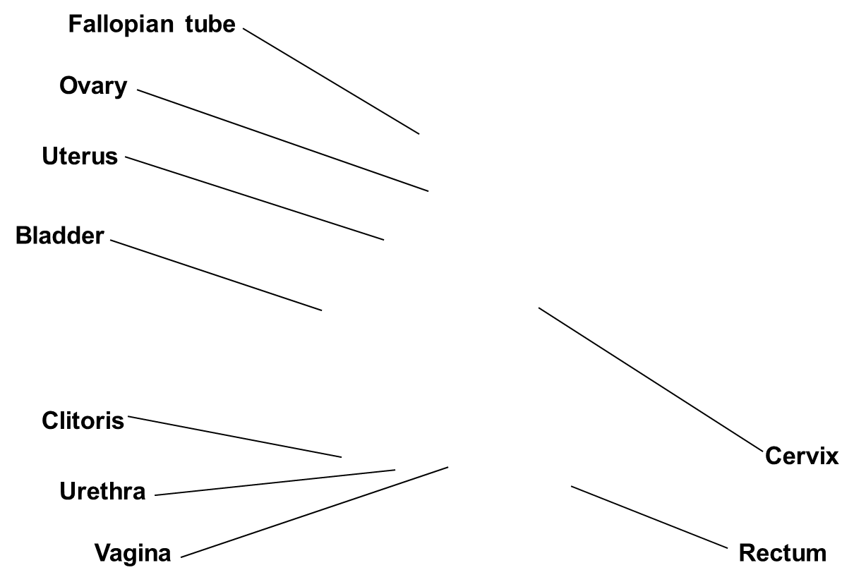
Reproductive System

Slide 4
Menstrual Cycle
Notes:
A menstrual cycle is the length of time it takes (an individual with a female reproductive system) for the body to go through the process of releasing an egg, preparing the uterus to cushion a fertilized egg, and then shedding the thickened lining and the unfertilized egg through vaginal bleeding.
The ‘period’ itself is one part of the female cycle. The medical term for getting a period is menstruation or “menses”.
Menstruation usually begins around the ages of 9 to 15. Every person has their own internal clock that determines when the events of puberty begin.
A female’s hormone system controls the menstrual cycle. The changes in a female’s body (including cramps, mood/psychological changes, and a period) are brought on by changes in the levels of hormones that are circulating through her system.
Ovaries produce hormones, especially estrogen, leading to breast development and periods.
Ovaries are filled with many eggs.
At a certain point, the pituitary gland located in a woman’s brain will release messenger hormones, FSH and LH, which “command” the ovaries to release an egg.
If sexual intercourse occurs and the egg is fertilized by a sperm, it leads to a pregnancy.
If an egg is not fertilized, the lining of the uterus, called endometrium, is shed through the vagina, leading to menstruation.
The cycle then begins again. It may take a few years for a young female to fall into a regular pattern of menstruation. Similarly, in the years leading up to menopause (usually around 50, when a female stops ovulating and her period stops), a female’s cycle can also be a bit unpredictable.

Slide 5
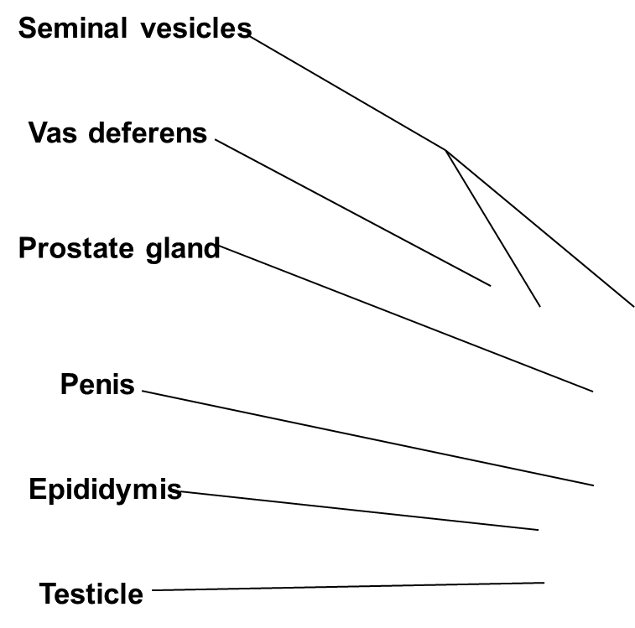
Reproductive System
Notes:
Individuals with penises (male reproductive system) have sexual organs both inside and outside the body. The internal organs include the epididymis, vas deferens, seminal vesicles, and prostate, and the external organs include the penis and testicles.
Vas Deferens – Another name for the vas deferens is the sperm duct. The vas deferens transport sperm from the epididymis to the urethra.
Seminal vesicles – Seminal vesicles secrete a thick fluid that nourishes the sperm.
Prostate Gland – The prostate gland enlarges to block urine from leaving the bladder when sperm is ejaculated.
Penis – The penis delivers sperm through the urethra. It is made up of two parts, the shaft and the glans.
Epididymis – The epididymis is where sperm matures.
Testicle – Another name for testicles is testes. They produce and store millions of sperm cells. They also produce the hormone testosterone.

Slide 6
Reproductive System
Notes:
Each sperm is very small; there are over 300 million sperm in 5 ml (1 tsp) of semen.
Millions of sperm are made every day in the testicles and stored in the epididymis. Sperm that are not released through ejaculation are reabsorbed by the body.
The sperm travel up the vas deferens and mix with fluid from the seminal vesicle and prostate to form whitish sticky fluid called semen.

Slide 7
Questions?
itsaplan.ca
sexandu.ca

